Slide 1
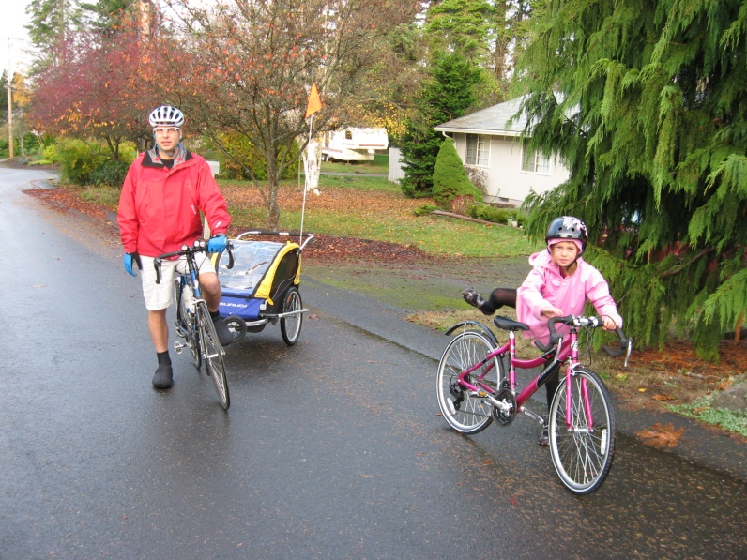
Commute Trip Reduction
Notes:
Geoff
Received $150,000 in in kind technical upgrades and cash by signing a 10 Year Lease….
Increased hospital’s electricity system’s reliability
Provided cash for premium energy systems
Partnership with Portland General Electric
Upgrade switchgear and installation of control and communications hardware at no charge.
All system maintenance and operation costs, including fuel, repairs, tune-ups, oil changes, filter replacements and overhauls.
Additional sound attenuation, if needed, quieting the generator system.
Testing of the system at least once a month under full load

Slide 2
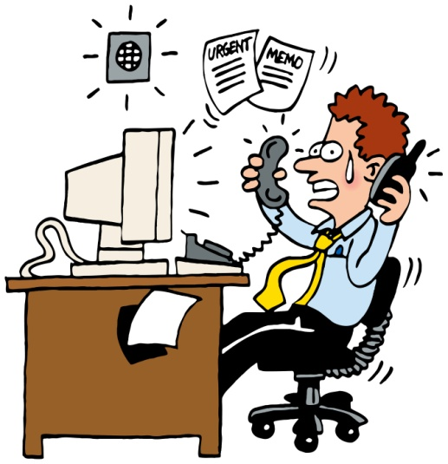
Commute Trip Reduction
Benefits to Employees
Save Money!
I save about $7000 a year!
*Based on 10,000 miles driven, $250 car payment & $3.50 gallon
Get Healthy!
Less Stress!
Get more done! (no driving)
Reduce Carbon Emissions

Slide 3
Commute Trip Reduction
Alternate Transportation
Mass Transit: Bus/Train
Buses 62A&B, 60
Vanpool-Carpool
Motorcycle/Scooter
Bicycle
Rollerblade
Walk

Slide 4
Commute Trip Reduction
Keys to Success
Don’t Rely on one Option.
Try it ONCE a month!
Mix it up!
BE CREATIVE!!!

Slide 5
Commute Trip Reduction
Obstacles to Success
Takes too much time!
Emergencies
Errands
Appointments
School Functions
Scary!
Overwhelming!

Slide 6
Commute Trip Reduction
Incentives
$18 Bus Pass (50% off!)
Donna Bortel (493-7377) near Public Elevator in Main Lobby (Finance)
Preferred Parking for Carpools, Vanpools and Cyclists!
Prizes, Raffles, Giveaways through Rideshareonline.com and the Daily News.
Guaranteed Ride Home Program for Emergencies.
Call PBX for a Cab Ride Home!

Slide 7
Commute Trip Reduction
How Can I help YOU?
Teach you how to use Bus
Or use an Intercity Transit Travel Trainer
Teach you how to dress (warm, not too warm, breathable, dry)
Provide Safety Class for Cycling & Walking
Use Rideshareonline.com- even for commuting between buildings.
Teach you to how to Use Bike/Walk/Bus on Google

Slide 8
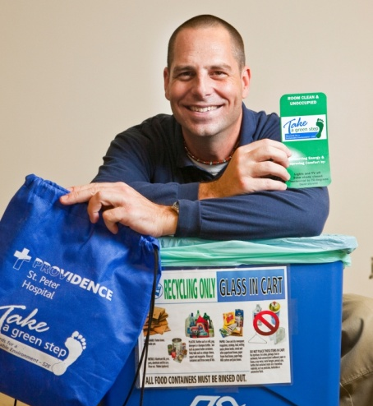
Keith Edgerton Construction Services, Sustainability & Employee Transportation Coordinator Providence Southwest Region 360.493.7059 keith.edgerton@providence.org

