Slide 1
Healing Patients and the Community
with Practice Greenhealth
Contact Information here
www.practicegreenhealth.org
Notes:
Our facility is committed to healthier environments for staff, patients and the communities we serve. We are proud members of Practice Greenhealth and are part of a national community of over 1,000 hospitals, where we share best practices, learn from each other and set annual goals to improve our performance. “Going green” is more than just recycling, we are taking a closer look at how we build, what we buy, the food we serve, chemicals in use and the amount of energy and water that are consumed. We have a responsibility to preserve our natural resources and provide quality care without negatively impacting human health and the environment and you are part of it!
1

Slide 2
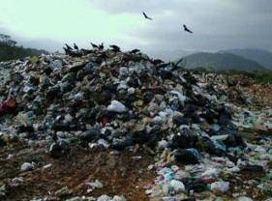
The health of the environment is connected to the health of people.
© Practice Greenhealth 2013. All Rights Reserved.
Notes:
It is important as healthcare professionals for us to understand the critical linkages between the health of the environment and human health. As we know better than most, human health is influenced by a variety of factors. The air we breathe, the water we drink, the food we eat and the products and processes we are exposed to every day—all play a role in our health. And as nearly 20% of the US economy, healthcare has tremendous purchasing power—and can use that purchasing power to leverage the market to develop smarter, more efficient and more environmentally responsible products and equipment. What we build, what we buy and how we operate MATTERS to the health of our patients, employees and our community.

Slide 3
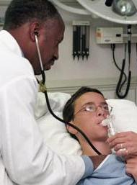
First, Do No Harm
Patient Health
Staff Health
Community Health
Notes:
The evidence is in – human health is dependent on planetary health. And as healthcare providers, we take an oath to first, do no harm. That ethos should extend to all the decisions we make about the ways in which we impact health. A commitment to the environment is a commitment to people. Every health care worker has a right to a safe, healthy and respectful environment. By minimizing chemicals of concern, serving healthier foods, reducing waste and resource use and building the next generation of high-performance healing environments, hospitals are demonstrating their commitment to healthier communities and to a healthy work force. The work positively impacts patients, staff the community and the world – it’s very powerful and by joining Practice Greenhealth, we are part of it!

Slide 4
Sharing Success!
MODIFY THIS SLIDE TO LIST WHAT YOU HAVE ACCOMPLISHED AT YOUR FACILITY.
Notes:
Going green isn’t a sprint – it’s a marathon and we have a lot of work to do. The only way to get there is one program at a time. We prioritize our initiatives to get the biggest value for environmental impact and value to staff and patients. In that spirit, we set annual, measurable goals. Education is key. We are introducing you to our initiative here but you will be exposed to more details at your departmental level and throughout your career.

Slide 5
THANK YOU
Notes:
NOTE: Only use this slide if your facility has won an Environmental Excellence Award.
We have been recognized by Practice Greenhealth’s Environmental Excellence Awards by winning the NAME OF AWARD GOES HERE. These accomplishments would not be possible without your participation. Our workers are our greatest asset and a healthier environment is something we all strive for together.

Slide 6
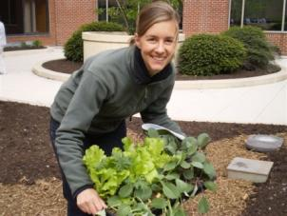
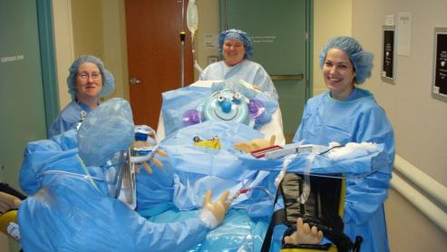
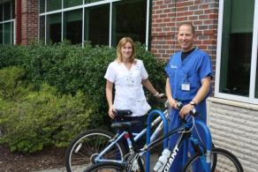
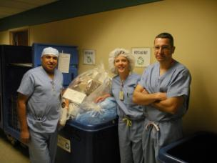
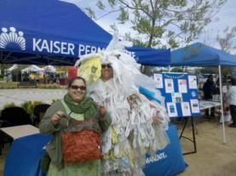
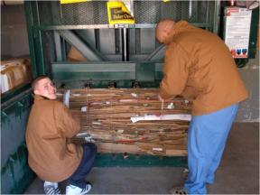
Wellness & Sustainability go hand-in-hand
Notes:
Our commitment is about you. Our goal is to create a healthy environment so you are best prepared to contribute to the healing of others. We appreciate you and this is one of the ways that we contribute to your health and wellness. Every worker has a right to a safe, healthy and respectful environment. There are many ways to participate in our initiatives, and we’re excited to have you a part of it.

Slide 7
Learn More
MODIFY THIS SLIDE WITH:
YOUR FACILITY INTRANET
Committee Structure (Green Team, Quality Teams etc..)
OR WEBSITE
NAME, CONTACT, PHONE
ADD YOUR LOGO HERE
Notes:
You can learn more about our environmental initiatives by visiting the following sites. All of our environmental initiative policies can be found in NAME OF MANUAL, INTRANET SITE OR DEPARTMENT. DESCRIBE ANY DEPARTEMNTAL TRAINING THAT THEY CAN EXPECT OR OTHER WAYS FOR THEM TO LEARN MORE.
Note: If you have any kind of departmental or champion initiatives, this is where it could be described. Describe any committee structure here or annual reporting, earth day events and more.
By joining our organization, you are part of a growing movement around environmental stewardship. We see a commitment to the environment as part of who we are. Welcome and we look forward to continuously improving upon our environmental programming. Join us! The more that get involved, the more powerful our progress.

Slide 8
www.practicegreenhealth.org
@pracgreenhealth
facebook.com/PracticeGreenhealth
PracticeGreenhealth (group)
© 2012 Practice Greenhealth
Notes:
Keep up to date on Practice Greenhealth activities through their various social media outlets. Learn about regional events and initiatives, articles, news releases and more. Thank you for being part of creating a healthy environment for staff, patients and the community.

