Slide 1
[Facility Name]: Saving Money in Purchasing [Category] using at Total Cost of Ownership Approach
EPP Case Study
Notes:
Category Example: Surgical Lighting

Slide 2
Facility Description

Slide 3
EPP Project – [Category]
[Facility] assessed [Product A, such as CFL light fixtures] and [Product B, such as LED light fixtures].
[Why these products were chosen]
[What is the goal desired]
Notes:
What are you evaluating and why?
example: Surgical Lighting

Slide 4
Getting Leadership Support
[ xx ]
Key Participants
[VP of Supply Chain]
Notes:
Describe how leadership support was achieved (example: case studies showing potential for cost savings; supplier marketing materials)
Describe key players involved

Slide 5
[Category]: Products Evaluated
General Information | Product A [Traditional Freezer] | Product B [Energy efficient Freezer] | Product C [Traditional Freezer 2] | Product D [Energy Efficient Freezer 2]
Product Description
Expected Product Life
Product Weight
Annual Operating Hours (or other Product Description Factor)
Product Power (or other Product Description Factor)
Electricity Rate (or other Factor)
Option: Insert category picture
Notes:
Edit/insert key pieces of general information about the category relevant to the case study; some examples provided

Slide 6
[Category]: Cost Elements Evaluated
Acquistion
Ex. Purchase price
Ex. Delivery
Use
Ex. Labor
Ex. Cleaning
Disposal
Ex. waste cost from packaging
Ex. waste cost from consumables
Notes:
List the type of costs that your organization considered in the assessment that fall under acquisition, use, disposal.

Slide 7
[Category]: Results
Summary results statement
[Insert chart from TCO results]
Notes:
Add summary results statements
Examples may include: Product has higher cost in Year 1 but saves $X over the total cost of ownership; Product has the lower cost when considering costs to operate (>6 years)

Slide 8
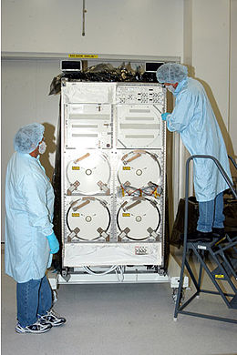
Tipping the Scale in Our Favor
[Category]: Results
[Energy Efficient Brand]
[Power]- $
[HVAC]- $
[Traditional Brand]
[Power]- $
[HVAC]- $
[Example Cost]- $
[Example Cost] -$
Insert picture that depicts category and any cost elements in use
Total- $
Total- $
Notes:
This illustrates the key total costs (all products) in a visual way and does not share confidential unit prices from the calculator.
Edit the data to add comparison of other products. List the products in order of cost with the least expensive first and the most expensive last, changing the red text boxes as needed.
Consider adding a picture for visual aid.

Slide 9
Lessons Learned
Notes:
Add two or three lessons learned through this process
Examples: Use a total cost of ownership approach for X products; use the calculator during the X process; getting calculator buy-in took X.

Slide 10
Conclusion: Benefits of Using a TCO Approach
Notes:
Describe the benefits to your organization in using a TCO approach.
Example: Identified savings that would not have been found any other way; the savings outweighed the staff time to do the evaluation; we will continue to use the calculator for X products
.

Slide 11
For more information
Name
Title
Organization
Email

