Slide 1
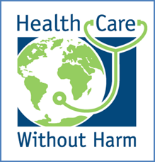
Every Day is Earth Day
Healing Patients and the Community
www.practicegreenhealth.org
www.healthierhospitals.org
www.noharm.org
Notes:
April 22 is Earth Day. A day to celebrate, educate and give back to our beautiful planet. In health care, there is a mission to improve the health of communities and a Hippocratic oath that clinicians commit to – an oath to do no harm. Thanks for joining us today to learn some facts about the connection between the health of the planet and human health and steps that hospitals and individuals are taking to create a healthier environment for staff, for patients, for the community and for future generations.
1

Slide 2
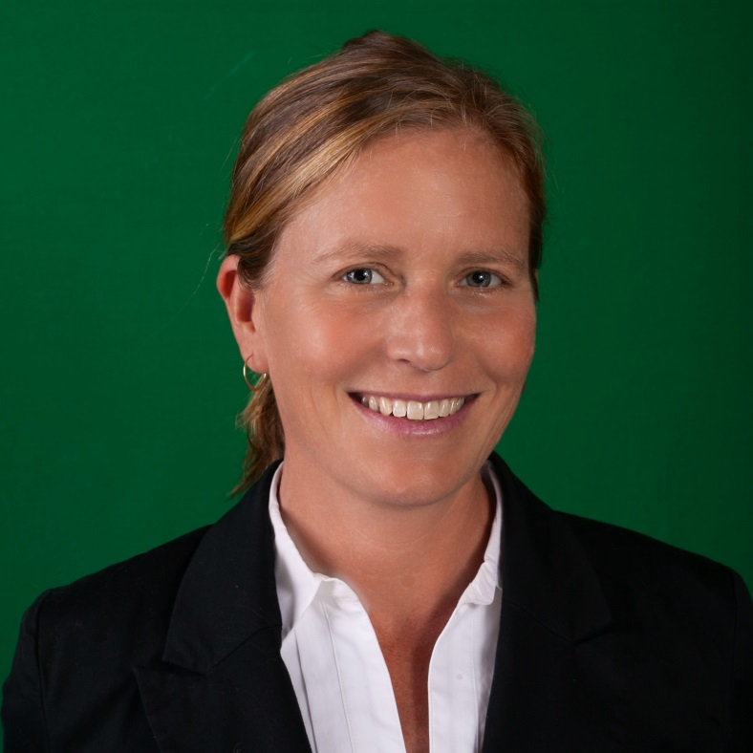
Building a Healthier Future
www.practicegreenhealth.org
www.healthierhospitals.org
www.noharm.org
Notes:
I’m Janet Howard. I have been working with hospitals and businesses and communities for over 20 years. I work for Practice Greenhealth and Health Care without Harm. Our mission is to do no harm – to work with hospitals to create healthier environments for YOU, and for the future. Every person deserves a healthy and safe environment and we can all take steps to improve the safety of our lives both at work and at home.
t’s an exciting time for change. Hospitals have been taking steps and we’re building momentum – and you are part of it. Thank you.

Slide 3
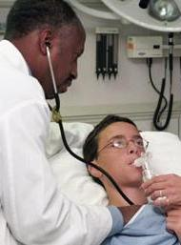
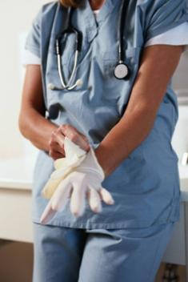
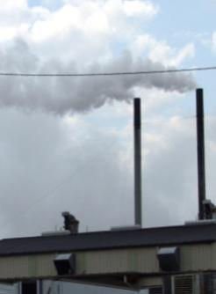
First, Do No Harm
Patient Health
Staff Health
Community Health
Notes:
When we talk about “the environment” – we mean lots of things. The communities where we live, the countries where we extract natural resources for materials and even by the patient bedside. We want to make all of these environments healthier. For all of us – for you, your families, your children and friends – The more we understand, the more we can take steps, individually and together, to make the world a healthier place.

Slide 4
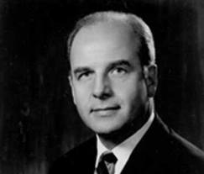
Earth Day
“Our goal is not just an environment of clean air and water and scenic beauty. The objective is an environment of decency, quality and mutual respect for all other human beings and all other living creatures.”
—Gaylord Nelson-Earth Day
Notes:
The first Earth Day started on April 22, 1970 by Gaylord Nelson while he was working as a U.S. Senator in Wisconsin. It became a world wide event in 1990. On the very first Earth Day back in 1970, 20 million people gathered in the streets of America to protest the industrial revolution. One in ten Americans took part in the first Earth Day activities with the result that, according to the New York Times, it ranks among “the largest participation in a political action in the nation’s history.” Every year on April 22, men, women, and children participate in neighborhood clean ups, learn about healthier practices, plant trees, clean up beaches or coral reefs, sign petitions, and think about how they can give back to the planet.

Slide 5
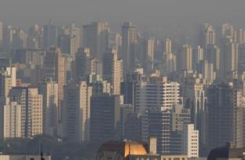
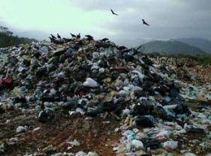
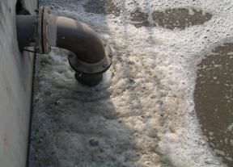
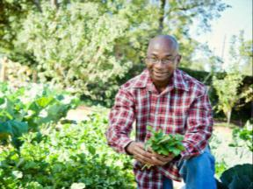
The health of the environment is connected to the health of people.
© Practice Greenhealth 2013. All Rights Reserved.
Notes:
The air we breathe, the water we drink, the food we eat and the products and processes we are exposed to every day—all play a role in our health. More and more people are realizing that we have to take better care of our planet – it’s the only one we’ve got. But we can learn how we can treat every day like it’s earth day. Human health is influenced by a variety of factors. By taking care of the planet, we are taking care of ourselves, our children, friends, parents and the future. Here are a variety of ways that man’s actions impact the environment and ourselves. Energy sources, driving cars, pesticides, herbicides even consumer products like nail polish and shampoo have an impact. The more we understand, the more we can work together to create a healthier future.
“Going green” is more than just recycling, we are taking a closer look at how we build, what we buy, the food we serve, chemicals in use and the amount of energy and water that is consumed. We have a responsibility to preserve our natural resources and provide quality health care without negatively impacting human health and the environment and you are part of it! And you can take steps to improve the health of your home and community, as well.

Slide 6
What is Environmental Sustainability, Going Green, Environmental Commitment?
Sustainability:
Latin sustinere – to hold up.
1. The capacity to endure, bear burden, hold up
“Meets the needs of the present without compromising the ability of future generations to meet their own needs”
Sustainability requires the reconciliation of environmental, social and economic demands – the three pillars of sustainability
Notes:
I’m sure you’ve been hearing a lot about sustainability lately – what is “sustainability,” “environmental stewardship” and “going green?” By definition, it’s about making decisions now that don’t negatively impact future generations or public health. The fact is, though, that humans are negatively impacting the environment – we consume far too much energy and water and generate too much waste. We use toxic chemicals, have transportation impacts and food systems that are out of balance with the earth’s ability to regenerate for future needs. And these same impacts on the environment can also impact human health – through the air we breathe, the water we drink, the food we eat and the chemicals to which we are exposed. While the language we use to describe healthier environments may be different, “sustainability” “Environmental Stewardship” “going green” the actions are the same. Taking a closer look at what we buy individually or as an organization and how we can work together for positive change – a step at a time. It’s a lot of work, we can’t do everything at once. But we can set goals for ourselves and for our organizations – goals that one at a time might seem small, but added up over time, they can have a huge and lasting impact.

Slide 7
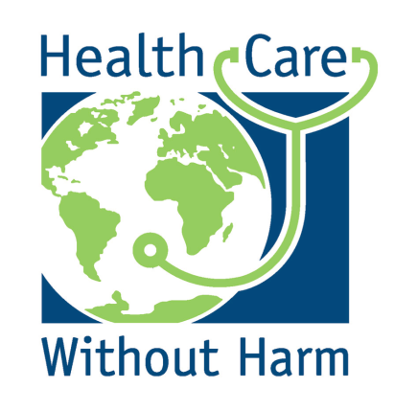
21st Century Chronic Diseases
Asthma rates doubled between 1980 and 1995. (Mannino 2002)
127 million Americans are overweight; 60 million are obese. (AOA 2006)
Between 1997 and 2004 diabetes incidence increase 45% among 18-44 year olds (CDC 2005)
Notes:
We have all experienced or seen the on the news, the outcome of extreme weather events. We have seen Hurrican Katrina. We have seen Superstorm Sandy. Flooding, damage, emergency response and a need to prepare for the next extreme weather event. What is global warming and what can we do about it? Carbon dioxide is the primary greenhouse gas causing global warming. Global climate change or global warming is a result of carbon dioxide surrounding the planet. Think of it like a puffy down jacket that is holding heat in for the planet. This might sound cozy but it’s a little too cozy – it’s warming the planet. We are experiencing the impacts of global climate change. Extreme heat resulting in heat stress, heat stroke, poor air quality and an increase in asthma – as temperatures goes up, air quality goes down and those with respiratory or cardiac frailty suffer the most. Wildfires continue which increase air pollution and ozone. Flooding comes with a loss of livelihood, loss of homes and death. Vector born diseases (sometimes transmitted by mosquitoes that are traveling beyond their usual geography) are coming north with the tropical weather. They bring diseases like West Nile virus and Dengue fever to regions that were not previously experiencing them.
Other greenhouse gases besides carbon dioxide include methane and ozone and there are anesthetic gases used in the operating room that are greenhouse gases, as well. On a personal level, when you drive a car, the engine burns fuel which creates a certain amount of carbon dioxide or CO2, depending on how much gas is used per mile and how far you drive your car. When you buy food and goods, the production of the food and goods also emitted some quantities of CO2. When we throw food away into a landfill, methane gas is produced, which is a greenhouse gas, as well, contributing to carbon in the atmosphere. Energy sources like gas, oil and coal are sources of carbon emissions contributing to global climate change. These are some of the sources of greenhouse gases and contributors to excessive carbon dioxide in the atmosphere.

Slide 8
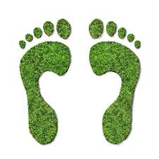
What is a Carbon Footprint?
A carbon footprint is defined as:
The total amount of greenhouse gases produced to directly and indirectly support human activities, usually expressed in equivalent tons of carbon dioxide (CO2).
Notes:
To preserve a livable planet, scientists tell us we must reduce the amount of carbon dioxide in the atmosphere from its current level of 400 parts per million (ppm) to below 350 ppm. And that is our task, as a sector and as individuals. and the way we can measure improvement or try to reduce the impacts of climate change is to reduce the amount of carbon dioxide that is generated individually and in businesses, like health care. Each one of us individually has a carbon footprint based on how we heat our homes, how much we drive cars and fly in airplanes, the types of products we purchase and how we discard our waste, to name a few. Businesses have started to measure their carbon footprint or, the amount of carbon they generate, so they can measure progress and contribute to the health of the planet. Every person and business has a role to play to reduce carbon emissions and reduce their carbon footprint.
In health care, there are many supplies to purchase and manage. The supplies are manufactured, often from very far away and then transported by plane or truck to the facilities. Hospitals use a lot of energy for heating and cooling and electricity for running medical equipment and lighting. All of these activities contribute to the carbon footprint. Of course, much of these activities cannot be avoided but people and hospitals can purchase equipment that is energy efficient or buy locally to reduce the distance that products are transported. They can also make sure to shut off lights when not in use and increase natural day lighting to reduce the need for lighting. These efforts reduce the carbon footprint.

Slide 9
Kaiser Permanente committed to reduce its greenhouse gas emissions by 30% by 2020
The strategy includes investing in clean and renewable energy sources while also targeting energy conservation measures
Invested $24 million in renewable energy (both on-site and RECs)
"These measures will improve the overall health of our communities and reduce our operating costs at the same time." Rame Hemstreet, Chief Energy Officer at Kaiser Permanente
Notes:
Leading hospitals are getting serious about climate change. Kaiser Permanente is investing in renewable energy which means the energy is naturally replenished from the wind or sun. A couple of things they did onsite to conserve energy was to switch surgical lights from halogen bulbs to LED bulbs, a more efficient bulb which resulted in reducing energy by 33% and reducing heat from the lighting. And reducing energy is also fiscally responsible. For regular bulbs throughout the hospitals, they switched to long lasting, higher quality light bulbs containing 72% less mercury and using 20% less energy. These practices can be realized at home too through buying LED lighting, which are more efficient, meaning they use less energy and last longer, reducing household expenses. We call that win-win – better for the environment and saves money.

Slide 10
Providence St. Peter, Olympia, Washington Reduced water use by over 30 million gallons per year
Report and fix any leaks
Low flow fixtures for showers, toilets and sinks
Plant native plants on grounds
Upgrade equipment
Notes:
Water is a natural resources that shouldn’t be taken for granted. Hospitals are accustomed to tracking their energy use but as we experience droughts, in regions like California, Colorado and other states, hospitals are realizing that as large users of water, it’s up to them to start understanding how much they use, where it’s used the most and to take steps to reduce wasted water. Hospitals use on average 550 gallons of water per staffed bed per day or 3.1 million gallons per operating room per year. Providence St. Peter in Olympia, Washington, has shared strategies towards achieving a 30 million gallon per year reduction in water use. Some of their tips include fixing any leaks in their heating systems and irrigation systems, fixing running toilets or leaking sinks, using low flow toilets, shower heads and sinks, and planting native plants that are drought tolerant and don’t need to be watered as much. Equipment upgrades offer water efficient equipment. A lot of these strategies can be done at home too. Shutting off faucets when not in use, filling up sinks to wash dishes, rather than leaving water running, low flow showerheads and planting native plants are all things that can be done at home.

Slide 11
Transportation Plan at Seattle Children’s
Notes:
Transportation is often overlooked when identifying pollution sources and opportunities for improved environmental performance in health care, yet cars contribute to smog, poor visibility and poor air quality, especially in congested areas. While one can’t smell carbon monoxide, it is emitted from cars and impacts people through reducing the amount of oxygen that is transferred to muscles and organs. Those at greatest risk are those with heart or respiratory disease. According to the EPA, in 2008, 27% of greenhouse gases came from transportation sources.
Seattle Children’s hospital’s goal is to reduce single vehicle car use from its current rate of 40% to the rate of 30% by 2028. Seattle Children’s Hospital has developed a “livable streets” initiative. They provide free transit passes to employees; for each day that an employee avoids the parking lot, they receive payment of $3.25 in their pay check to reward them for not using the parking lot. Seattle Children’s developed their own transit program, with the use of 22 mini vans (all with bike racks), seating 14 people each, which take passengers from transit hubs to the facility or the research facility downtown. The small vehicles offer flexibility to meet the changing demands of the staff and move over 350,000 people per year. They also give out free bicycles to staff. Creation of bike boulevards, and other improvements make biking and walking safer. With the tremendous number of staff within walking distance of the hospital, addressing safety promotes walking.

Slide 12
VA New Jersey – Healing Gardens
Notes:
The VA New Jersey Health Care System received $100,000 from a VHA Innovation Funding for the Advancement of Patient-Centered Care grant to construct a greenhouse so that the veterans could garden and receive instruction on landscaping and storm water management year round. The 26’x36’ greenhouse would make it possible to continue growing tomatoes, herbs and potential income from developing their own farmer’s market.
Acquisition of a greenhouse was seen as a sustainable strategy for veterans to receive therapeutic, educational, and vocational rehabilitation, compensated work therapy and created continuous employment opportunities year round. The greenhouse was manufactured for wheelchair accessibility and facilitates year round plant production. Veterans established a veteran- operated farmers market as a greenhouse goal.

Slide 13
W. EUGENE SMITH 1975 PHOTO ESSAY MINAMATA: WORDS AND PHOTOS
Tomoko
1956-1977
Notes:
This is a photograph that was printed in Life magazine in 1975, depicting the devastating affects of mercury poisoning in Minamata Bay japan. This mother is lovingly caring for her child and while the mother appears healthy, the mercury-tainted fish she ate while pregnant, interfered with her unborn baby’s brain development resulting in permanent damage. Mercury is a silver, liquid metal that used to be common in thermometers and we now know that mercury is dangerous to humans. In 1997, a report to Congress showed us that that medical waste incinerators, where waste from hospitals was burned, were a major source of mercury in the environment. Mercury in waterways, works its way up the food chain and is returned to humans through fish consumption. This was wake-up call to the sector that in the process of providing health care, hospitals were negatively contributing to human health and the environment through mismanagement of health care waste. Many hospitals have phased out mercury and don’t use it anymore. And in the small number of areas where it is found, it is managed carefully and not put in the regular trash. Mercury can be found in very small amounts in fluorescent light bulbs. So when throwing away any mercury-containing device, check with your community to find out about hazardous waste collection days for proper disposal of mercury. By the way, the message here isn’t to stop eating fish but to eat fish from a variety of sources and if in child-bearing years, to keep intake of swordfish, shark, king mackeral, tilefish and some would add, tuna, to a minimum.

Slide 14
Why Safer Products?
Widespread exposure to many chemicals
Almost half of all Americans live with chronic disease
Government agencies are unable to protect us
Health professional associations call for health-protective laws
Health care purchasing can move economy to safer products
Notes:
We talked about carbon emissions and global climate change. But there are other ways that humans are affected by the environment. Chemical exposure is a contributor to disease and of particular concern for women of child-bearing years, pregnant women and children. By understanding issues around chemical exposure, individuals can take steps to reduce exposure through safer cosmetics, cleaning chemicals, art supplies, food, pest control and other sources. According to data from the Centers for Disease Control and Prevention, our bodies contain hundreds of toxic chemicals that we are exposed to through the products we use every day—in our homes, in our places of work, in our schools. Babies are no exception. A few years ago, a UCSF study of pregnant women found that virtually all pregnant women in the United States carry multiple chemicals in their bodies, including some banned since the 1970s and others used in common products such as furniture, non-stick cookware, processed foods, and personal care products. Human disease results from complex interactions among genes and the environment. In addition to personal lifestyle factors, exposures to chemicals are increasingly recognized as important and preventable contributors to human disease.
Although mortality is declining, leukemia, brain cancer, and other childhood cancers have increased by more than 20% since 1975. The risk of breast cancer has tripled from more than 1 in 20 to 1 in 7 in the last forty years. Nearly 1 in 12 Americans suffer from asthma. As of 2008, nearly 1 in 6 children has a learning or developmental disability. The risk of each of these diseases is increased with exposure to various environmental chemicals in human studies.
In spite of all the money we’re spending on health care and in spite of the wonderful medical advances that are keeping us alive, we’re sicker then we used to be.
Most people assume that if a chemical is on the market and used in consumer products, it must be safe. Unfortunately, this is not true. Our government agencies don’t have the legal authority or data they need to determine the safety of chemicals we’re exposed to every day.
The nation’s major health professional organizations are urging policy makers to address this problem. The American Academy of Pediatrics, the American Medical Association, the American Nurses Association, the American Congress of Obstetricians and Gynecologists, the American Public Health Association—all of these groups and more have called on Congress to update our laws to make them truly health protective.
In the meantime, health care sector purchasing can help move the market. The U.S. health care industry spends more than $200 billion annually on medical and non-medical products. By adopting aggressive environmentally preferable purchasing policies, health care institutions can help drive the economy away from harmful chemicals and toward safer products.

Slide 15
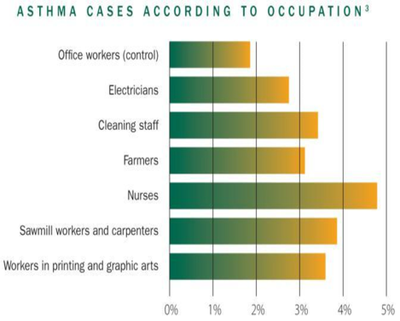
“The incidence of environmentally
caused cancers is grossly underestimated.”
Presidential Cancer Report, 2009
U.S. National Institutes of Health
The Lancet, 2007
Notes:
The presidential cancer report noted that the incidents of environmentally caused cancers is grossly underestimated. So there is a link between exposure to certain chemicals at certain amounts at certain times that can link to cancers. Scientists are studying when and how this happens but with the increased understanding that chemicals can cause harm, hospitals and individuals are taking steps to reduce the use of hazardous chemicals in use at work and at home. We aren’t suggesting that all chemicals can be eliminated but we can work to choose safer chemicals and to make sure that whether at home or at work, there is a safe way of handling these materials that prevent exposure – meaning, either through gloves or a mask or fresh air, you are not breathing in or soaking in harmful chemicals that can cause harm. Are you one of those people that feels nausea around perfume or fragrances? Have you been dizzy when working with a chemical? These are called symptoms of exposure – listen to your body and avoid chemicals when possible or make sure you are properly protected from chemical exposure. Health care workers can talk to their supervisor, ask to review the material safety data sheet or MSDS and consumers can read product labels and look at the ingredients in products.
A 2007 study in the Lancet found that nurses have the highest rates of work-related asthma of any of the worker populations studied, followed closely by cleaning staff. The study hypothesized that exposures that led to work-related asthma included cleaning chemicals, latex (which has largely been addressed in the U.S.), and high level disinfectants like glutaraldehyde. These issues can be addressed by going to what we call “greener cleaners.” It’s hard to tell if a cleaning chemical is “green” since so many might have a healthy sounding name without being healthy at all. Organizations like GreenSeal or Eco Logo offer a certification so that consumers of cleaning products can feel confident that the cleaner is healthier for their use than non certified cleaners. So read those labels.

Slide 16
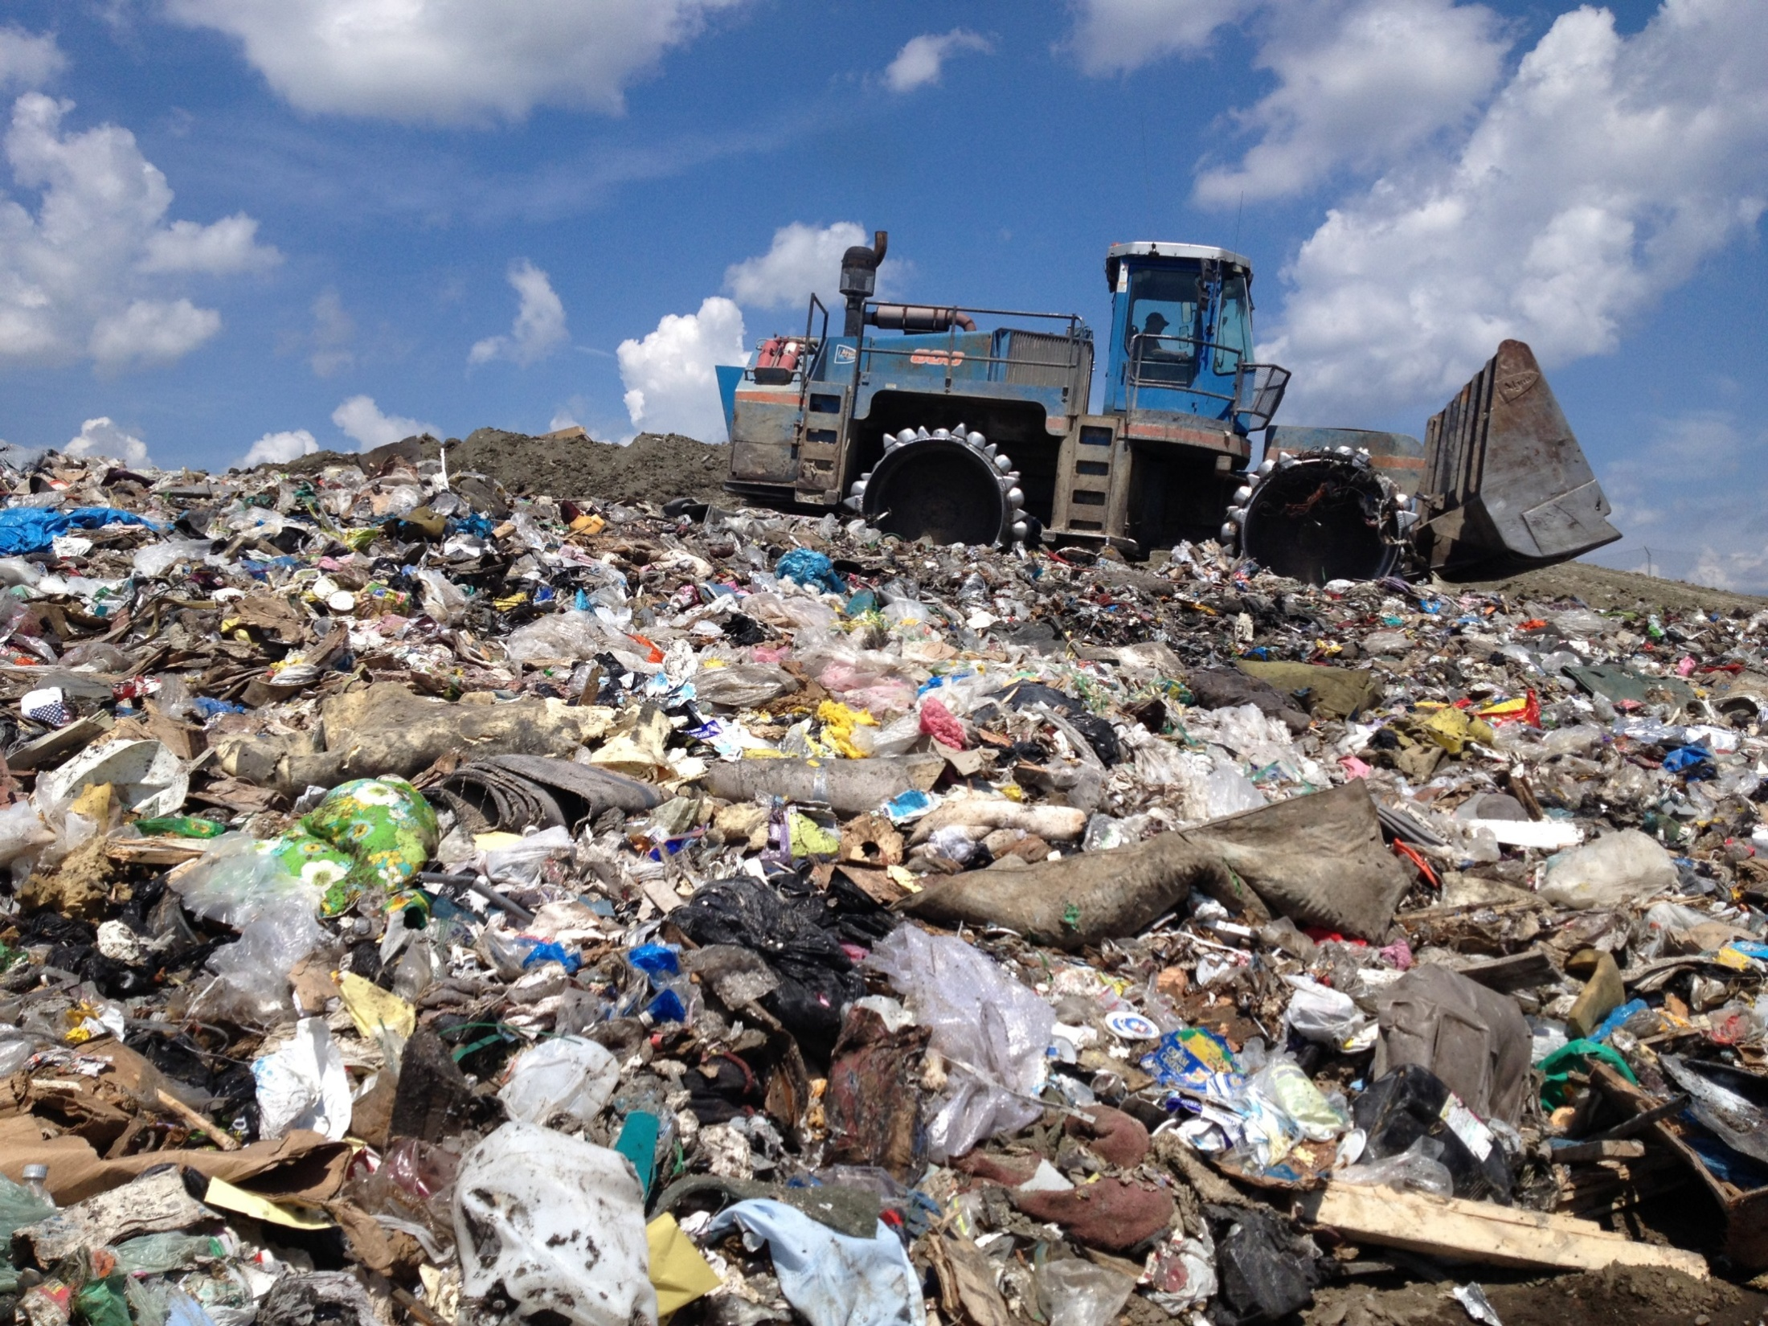
Notes:
This slide was provided by the State of Vermont. Whether in a hospital or at home, let’s be honest – we generate a lot of waste! Hospitals generate over 30 pounds of waste per bed per day and there are things that can be done at home and at work to make less waste. We can use reusable shipping containers and shopping bags, we can recycle and donate materials and we can make sure we follow laws for safe disposal of hazardous materials.
Just remember – there is NO away. Everything we discard as “trash” is either burned or buried. And either choice leads to increased pollution and environmental impact.

Slide 17
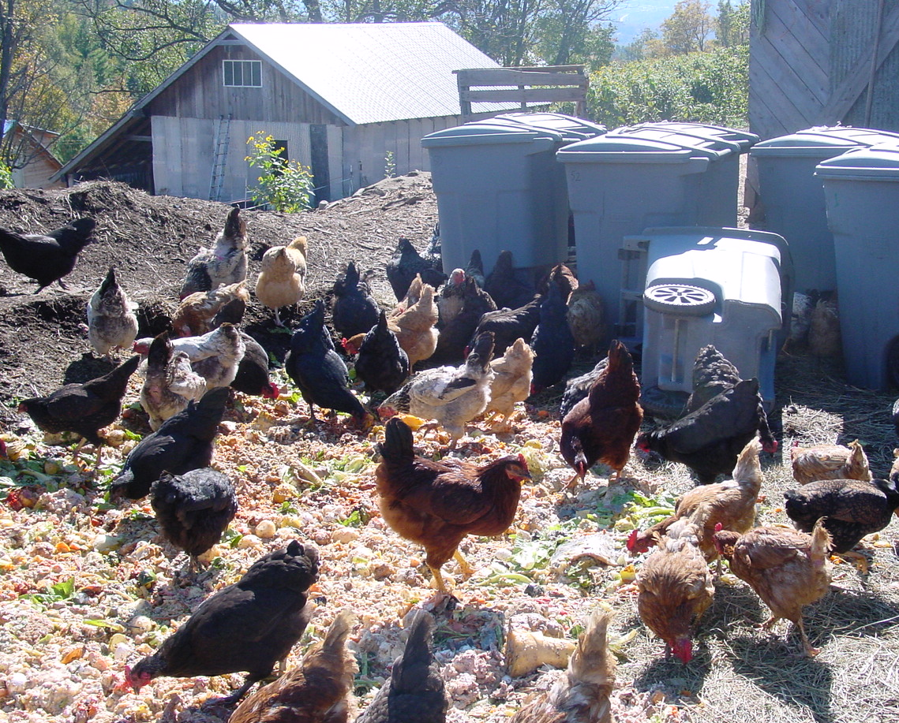
Materials Management
Notes:
Through resources conservation, recycling and composting, we can start to think of waste as material, rather than garbage and think of ways we can prevent it from going into crowded landfills. The state of Vermont has mandated composting for large generators. The USDA reports that 40% of the food grown in the United States is wasted! When we put food waste into landfills, it produces a gas called methane which contributes to global climate change. Ask about composting at your hospital or in your neighborhood. Keep food waste and recyclables out of the trash. If you work in a hospital, participate in recycling programs and only discard potentially infectious materials in red bags. If you ever aren’t sure where something goes? Ask!

Slide 18
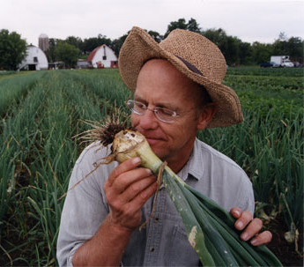
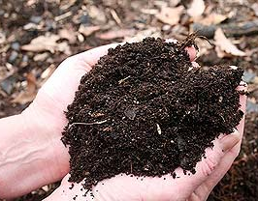
Closing the loop on the food system
Schools,
Businesses,
& Institutions
Hauler
Farmer/
Composter
Notes:
18
This slide from the state of Vermont helps us understand that food waste can be collected, composted and used to nourish farm land – it completes the cycle. We can take steps to make less food waste and try to get it back into the earth in a healthy way – through composting. This is a way to see waste as a nutrient and the role it plays in healing the planet, not harming it through being buried in a landfill. At home, only buy what you need, try to reduce or prevent waste.

Slide 19
Action:
Eliminated water bottles for…
Patient Rooms
Cafeteria
Meetings
Vending Machines
Notes:
According to National Geographic, Americans drink more bottled water than any other nation. And bottled water is expensive. It is not healthier than tap water and the production of plastic bottles requires millions of barrels of oil per year and the transportation of bottled water from its source to stores releases thousands of tons of carbon dioxide. Hospitals like Bon Secours New York Health System tookk steps to eliminate water bottles from patient rooms, from vending machines and cafeterias. Individuals can take steps to eliminate water bottles too. You can refill a bottle and drink tap water, which is no less healthy than bottled water. This can save money and reduce waste.

Slide 20
What is Environmentally Preferable Purchasing?
Notes:
It might seem strange to think that what goes on in a hospital could effect the global environment, but it can. Have you ever wondered where all the materials come from that are used in hospitals? Or where waste goes when it’s not needed anymore? This is called the “Supply Chain” and the more we learn about it, the more we realize that what we buy has a big impact on health and on people across the world.
When we buy things, we are impacting the supply chain – Think of the journey that a product makes to get to the store or the hospital where it is purchased or used. Natural resources had to be taken from the planet to provide the material for the product and then that material had to be transported somewhere to be made and then distributed across the world. Once it’s used and either breaks or isn’t needed anymore, it travels in trucks to incinerators or is put in the ground, in a landfill, where it can remain for hundreds of years. Incinerators can be of concern because when we burn waste, it can impact the quality of the air. Products put in the ground can travel and get into the water supply and then affect water life. And then if we eat things out of the ground or the water, we can be exposed to certain chemicals. But we can make a difference when we make purchasing decisions. You can reuse shopping bags to make less waste. You can buy healthier materials or repair things instead of throwing them away. This is called environmentally preferable purchasing. It means we think about health when we buy things. And hospitals are taking steps to buy healthier food, reduce packaging, buying safer chemicals and taking other steps to improve the health of the products and services they buy. The only way products will be made in a healthier way if those that consume them ask for healthier alternatives.

Slide 21
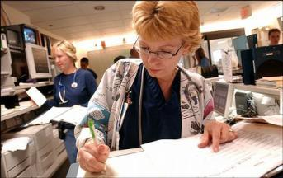
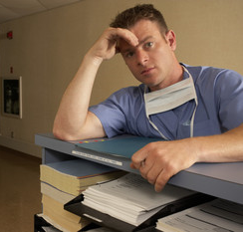
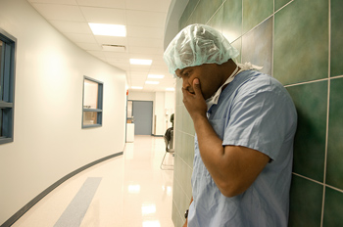
Stress on the job, at home…
© Practice Greenhealth 2013. All Rights Reserved.
Notes:
These are challenging times. As health care professionals or as any person knows, we are confronted every day with a lot of incredibly important priorities. It can sometimes feel overwhelming – families, work, commuting, maintaining a home, never enough time to do all we need to do – it can get stressful. Stress can lead to poor health as well – headaches, high blood pressure, poor eating habits – it’s important that we take care of ourselves through healthy habits and stress reduction strategies like yoga, walking, jogging, listening to music and meditation. Taking a break, walking away or a personal “time out” can help maintain balance and emotional well being.

Slide 22
Case Study: Greening the OR / Awareness Campaign
Benefits: reduce RMW volume and increase recycling
Challenge: improper disposal, safety risks
Strategy: build awareness through in-services, roundtables, audits, engage staff
Results: more engaged staff, improved disposal, great feedback
Inova Health System
Notes:
Inova Health System is a not-for-profit health care system based in northern Virginia that serves more than two million people each year from throughout the Washington, D.C. metro area and beyond. Inova Health System is greening their operating room and making it fun too. “Blue Wrap” or disposable wrap used to package instruments before they are sterilized is a big contributor to the operating room waste stream. Hospitals are collecting their blue wrap for recycling, they are reusing it by using this sterile wrap for packaging or donating to local veterinarians for their use. But at hospitals like Inova, a blue wrap fashion show helps to educate and make it fun.

Slide 23
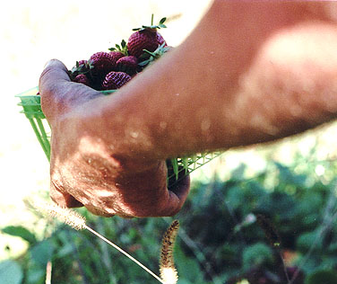
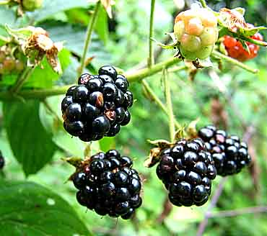
23
Healthy Food in Health Care Program
www.healthyfoodinhealthcare.org
Notes:
The Healthy Food in Health Care program is gaining momentum as individuals and hospitals recognize that our health is impacted by what we eat. Hospitals can model healthier behavior by educating patients and staff on healthier food choices. The food system is connected to health, global climate change and local communities. Ask your hospital about their healthier food initiative and if they are working with your community to make the connection between food and health.

Slide 24
Meat Consumption and Health
On average, Americans eat three times the amount of meat recommended by the USDA
High consumption of meat fats and
processed meats: increased risk of
obesity, diabetes, cardiovascular
and other diet-related diseases
Individual meat consumption comes with a high social cost: environmental, public health, climate change, labor
Hospitals typically serve meat 2-3 meals per day
Antibiotics
Notes:
Eighty percent of all the antibiotics consumed each year are routinely given to poultry, beef cattle, and swine in their feed, not to treat diagnosed disease, but to promote faster growth and to prevent disease outbreaks. A January 2014 study by the Centers for Disease Control and Prevention showed that resistant microbes kill at least 23,000 people each year and complicate treatment and recovery for two million more. According to the study, health professionals characterize the threat as the largest challenge facing modern medicine. The Centers for Disease Control (CDC) estimates the care costs from these diseases are as high as $20 billion a year and lost productivity as high as $35 billion a year.
Hospitals and schools are leading the effort to purchase meat raised without the use of non-therapeutic use of antibiotics so that we can preserve their viability as a critical lifesaving tool for medicine. Hospitals are reducing their serving size, increasing vegetarian options or hosting “meatless Mondays” to help promote healthier eating. Have you taken steps to reduce meat in your diet?

Slide 25
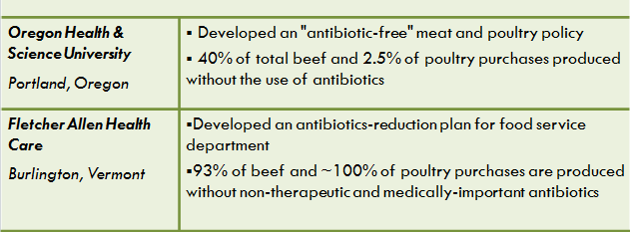
Hospital Purchasing Case Studies
Notes:
Oregon Health & Science University (OHSU) in Portland, Oregon developed a sustainability policy aimed at procurement of "antibiotic-free" meat and poultry. Forty percent of their total beef and 2.5 percent of poultry purchases are now produced without the use of antibiotics.
In 2007, Fletcher Allen Health Care in Burlington, Vermont developed an antibiotics-reduction plan for its food service department. Five years later, 93 percent of beef and nearly 100 percent of poultry purchases are produced without non-therapeutic and medically-important antibiotics. This is very important in helping antibiotics continue to be effective when needed for treating illness.

Slide 26
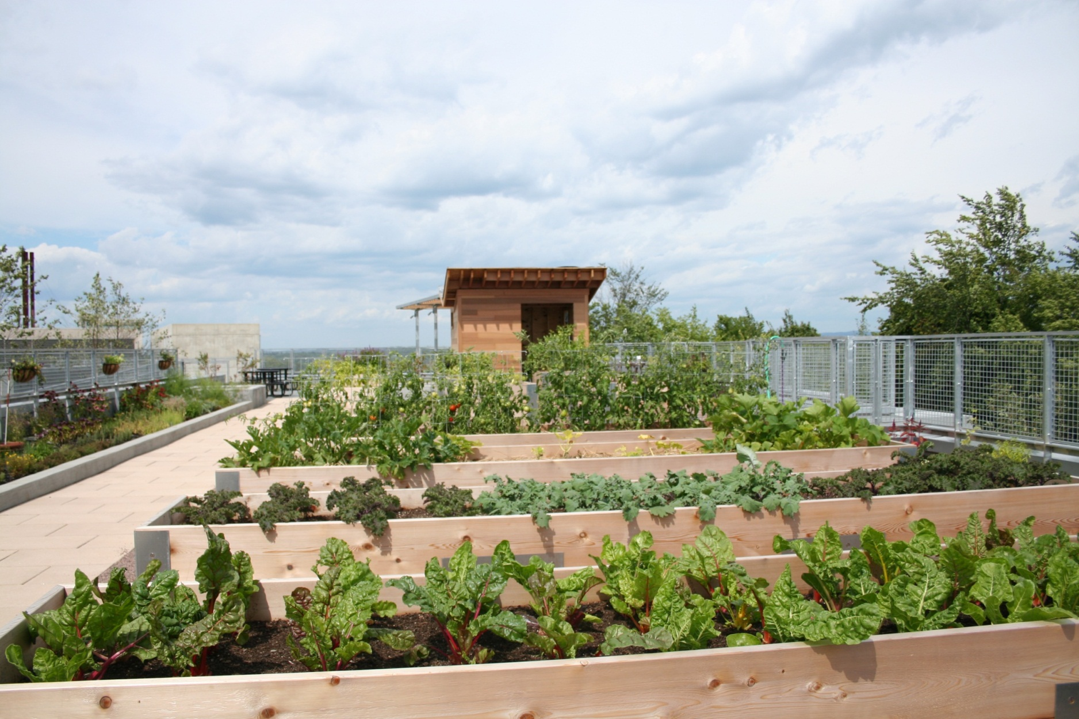
Notes:
This is a roof top garden at Fletcher Allen in Vermont. The executive chef works with the line chefs and volunteer staff to plan what they will be growing in each garden. A line chef is assigned to each garden and is in charge of making sure to use the vegetables on salad bars or in recipes. Hospitals are increasingly hosting community gardens and farmer’s markets to think about gardening as an opportunity for education, therapeutic support and healthier food offerings for staff, patients and the community. Volunteers at St. Joseph, a Dignity Hospital, planted a 4,000-square-foot garden where they harvest and distribute vegetables to those in need through St. Mary’s Interfaith, a local soup kitchen located in downtown Stockton, California. The garden also has taken on greater meaning for volunteers and for the community. The local paper made the garden front-page news. As John Kendle, one of the volunteers stated, “It’s a breath of fresh air for the entire community,”

Slide 27
Notes:
Inova Health System is committed to promoting healthy, sustainable consumption habits within its facilities and its local communities. Inova supports the community through its innovative Double Dollars program, which supplements the use of SNAP benefits at local farmers’ markets and provides incentives for food stamp recipients to purchase fresh, nutritious, sustainable foods. The program allows consumers to buy fresh fruits and vegetables that otherwise may have been cost-prohibitive by doubling the first $10 in SNAP benefits that are spent at the market.

Slide 28
Leadership Walks, Talks, Envisions…
“ Health care organizations need to be honest with themselves and ‘look in the mirror’ when it comes to environmental factors that affect human disease. Our mission is to improve the health of the communities we serve, and we cannot accomplish this mission without looking at our organization’s environmental impact and how that contributes to disease.”
Jeffrey Thompson, MD, CEO Gundersen Lutheran Health System La Crosse, Wisconsin
Notes:
And when leadership is onboard – there’s no end to the possibilities. Every single person has a role to play with healthier environments and those making the most impact and the furthest progress, have leadership standing tall, front and center and leading by example. People like Dr. Jeff Thompson, MD and CEO of Gundersen Health who says, “The best part is that we can achieve this mission while, at the same time, reducing the cost to deliver care by passing along savings we see from our sustainability programs.”

Slide 29
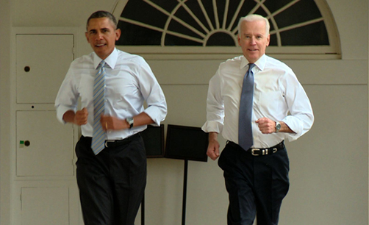
Learn More: www.letsmove.gov/
Notes:
Even the White House gets it! You can learn more about how to eat healthier and exercise and the first lady, Michelle Obama’s let’s move campaign at www.letsmove.gov.

Slide 30
How can you get involved?
Hospitals are joining together for powerful change
Health care workers are forming teams around healthier food, less waste, conservation and safer chemicals
Patients are asking their hospitals about their environmental improvement programs
Join the Community!
Notes:
If you work in a hospital or any business for that matter – get involved! By participating in recycling programs, turning off lights and carpooling to work, you are part of the solution. Ask your supervisor how you can get involved and let your leadership know it’s important to you. If you are a community member, write a letter to your local hospital and let the president, CEO or board of directors know that healthier environments are important to you. Ask them what they are doing at their facility. Think about things you can do at home. Take a walk, don’t litter, local eat fruits and vegetables and be careful to educate yourself when using chemicals for cleaning, for killing bugs or for fertilizing your garden. Take public transportation when possible, shut off lights when not in use and lower the thermostat at night. Hospitals have a mission to prevent illness and heal. It’s only logical that hospitals would play a leadership role in their communities and help others understand the connection between the health of the planet and human health.

Slide 31
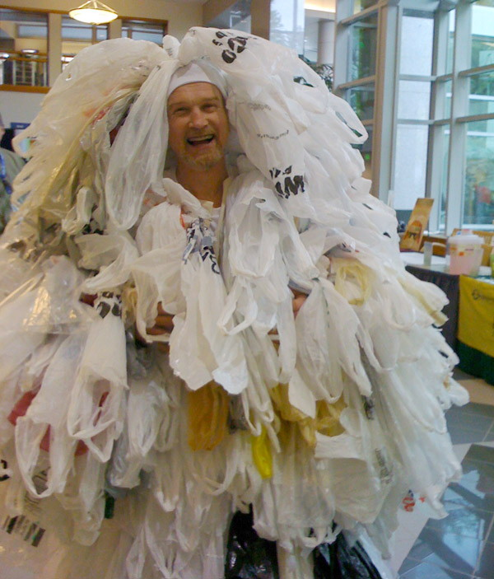
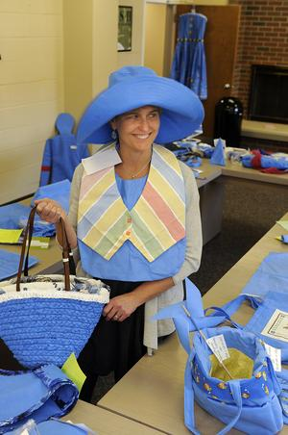
Earth Day Activities
Art contests
Crafts
Fashion
Computer collection
Farmer’s markets
Clean up events
Educational events
Fairs
Bag Monster – Jim Overton, RN
Evergreen Hospital
Jen Ogden RN, BSN, CNOR , Operating Room Educator, Shawnee Mission Medical Center
Amy Collins, MD
MetroWest Hospital, MA
www.practicegreenhealth.org/earthday
Notes:
Remember – Earth Day is a day to celebrate and give back. But, especially in health care, every day is Earth Day. Make it fun, get creative and feel good knowing that anything you do, no matter how small, is important. At work, ask your leadership how you can be more involved in creating healthier environments and what you can do to make a difference. Every single person has an important perspective in how to make the workplace healthier. No one knows your perspective. Bring your ideas to your supervisor, offer your important insights and feel empowered to do your part.

Slide 32
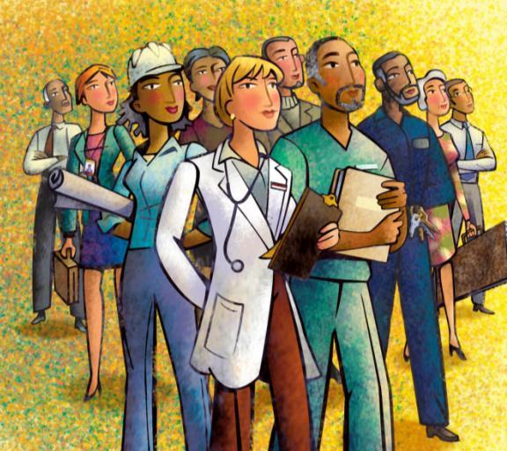
A Learning Community
Educate
Motivate
Celebrate
Notes:
The Practice Greenhealth and Health Care without Harm community work to educate, motivate, support and celebrate environmental excellence in health care. The solutions are as unique as the facilities and individuals that work in them. Large, small, rural, urban, stand-alone or part of a health system, hospitals can share strategies, learn from each other and take baby steps to healthier environments. It takes team work – a shared responsibility. Your participation matters and every program, every step takes the sector to a healthier future.

Slide 33
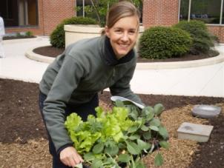
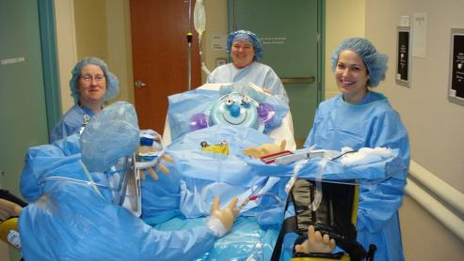
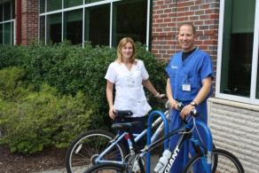
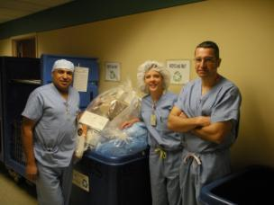
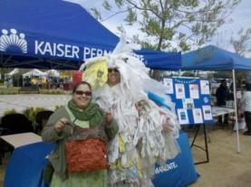
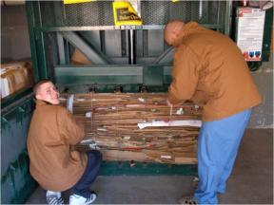
Wellness & Sustainability go hand-in-hand
Notes:
It’s really about people. Respecting the earth is respecting people.. Every health care worker has a right to a safe, healthy and respectful environment. By minimizing chemicals of concern, serving healthier foods, reducing waste and resource use and building the next generation of high-performance healing environments, hospitals are demonstrating their commitment to healthier communities and to a healthy work force. The work positively impacts patients, staff the community and the world – it’s very powerful.
Our commitment is about you. Our goal is to create a healthy environment so you are best prepared to contribute to the healing of others – whether at work or at home. We appreciate you and this is one of the ways that we contribute to your health and wellness. There are many ways to participate in healthier initiatives, and we’re excited to have you a part of it.

Slide 34
www.practicegreenhealth.org
@pracgreenhealth
facebook.com/PracticeGreenhealth
PracticeGreenhealth (group)
© 2012 Practice Greenhealth
Notes:
Keep up to date on Practice Greenhealth activities through various social media outlets. Like us on facebook. Learn about regional events and initiatives, articles, news releases and more. Thank you for being part of creating a healthy environment for staff, patients and the community.

Slide 35
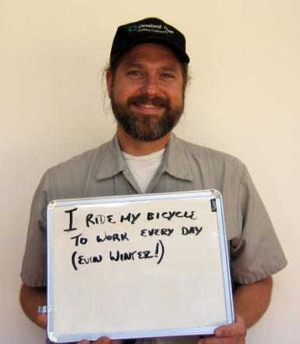
Up for the challenge?
Photo Credit — Cleveland Clinic Office of a Healthy Environment
35
Notes:
Our work is only as powerful as individual involvement. Are you up for the challenge? What are you going to do to make your life healthier? How are you helping to heal the planet?
35

Slide 36
Every Day is Earth Day What will you do to say thanks to the planet today… and everyday?
Thank you
Notes:
I’m Janet Howard, thanks for taking some time to learn more about healthier environments and why they’re important to all of us. Each of us can take steps to live healthier lives and hospitals can lead communities to a healthier future. Thank you and Happy Earth Day – but remember. Every day is earth day. Learn more at www.noharm.org or www.practicegreenhealth.org.

