Slide 1
Delivering Community Benefit: Climate and Health

Slide 2
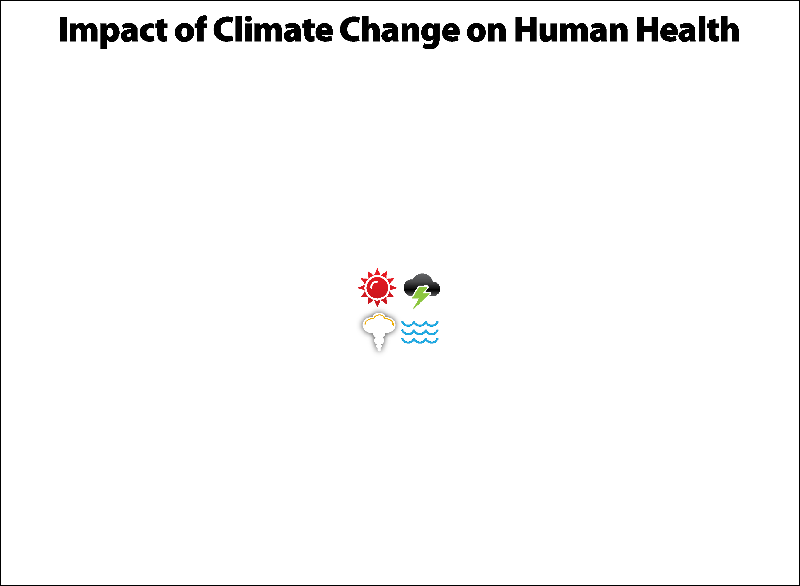
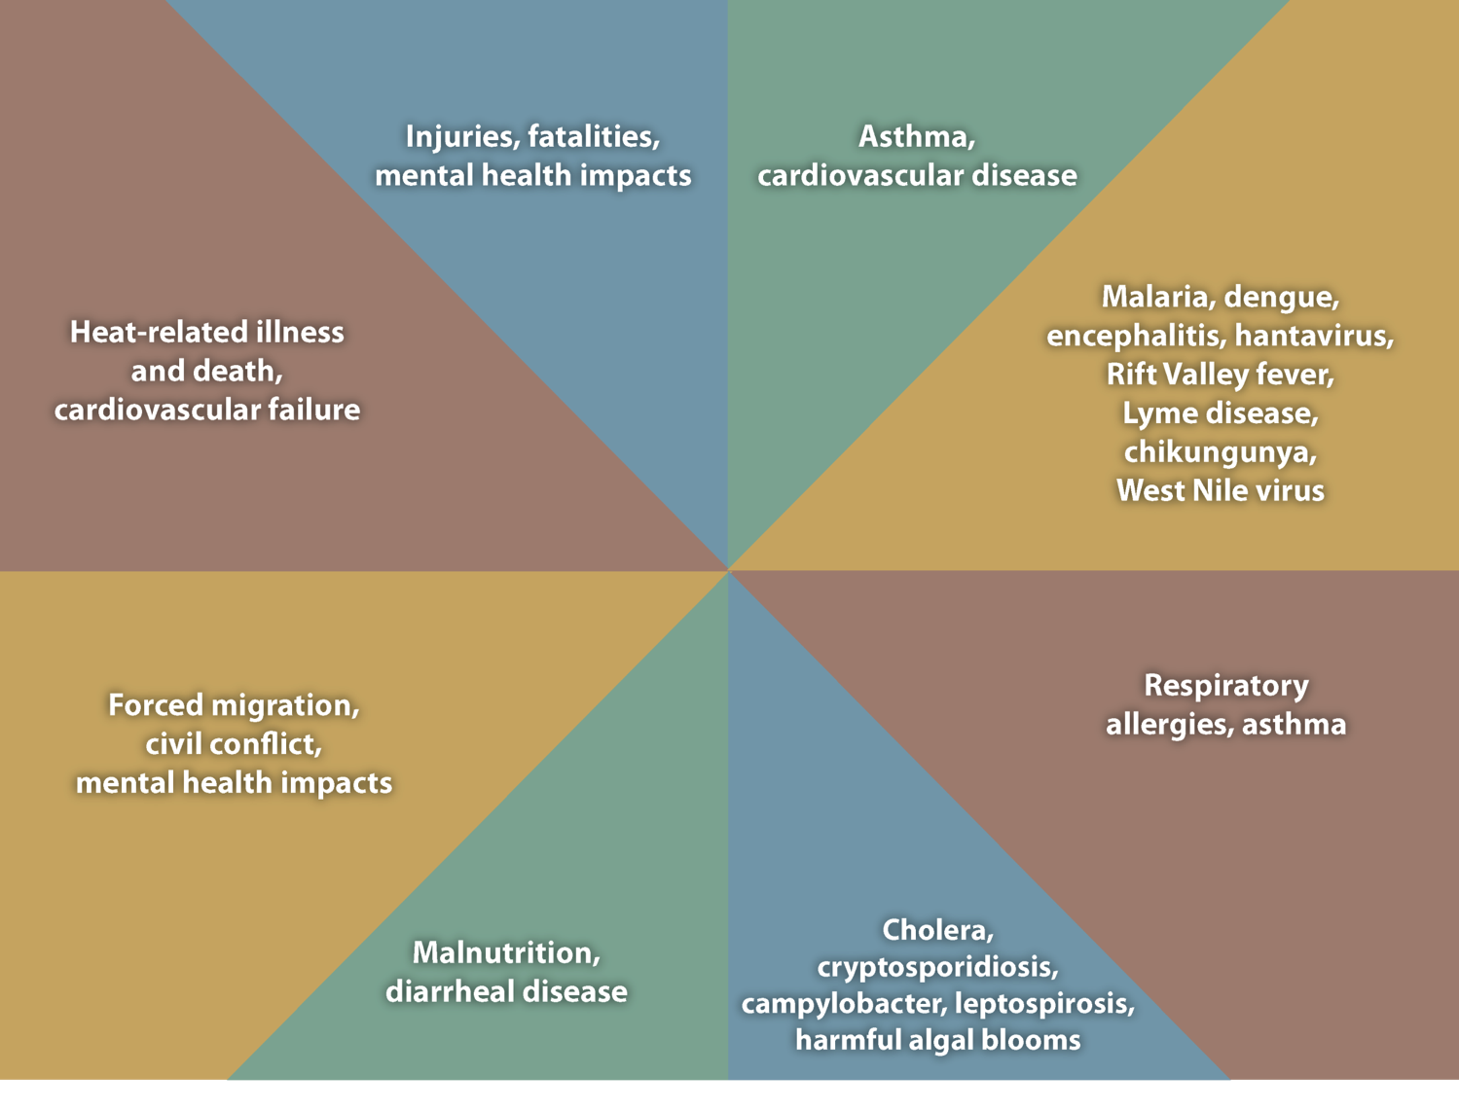
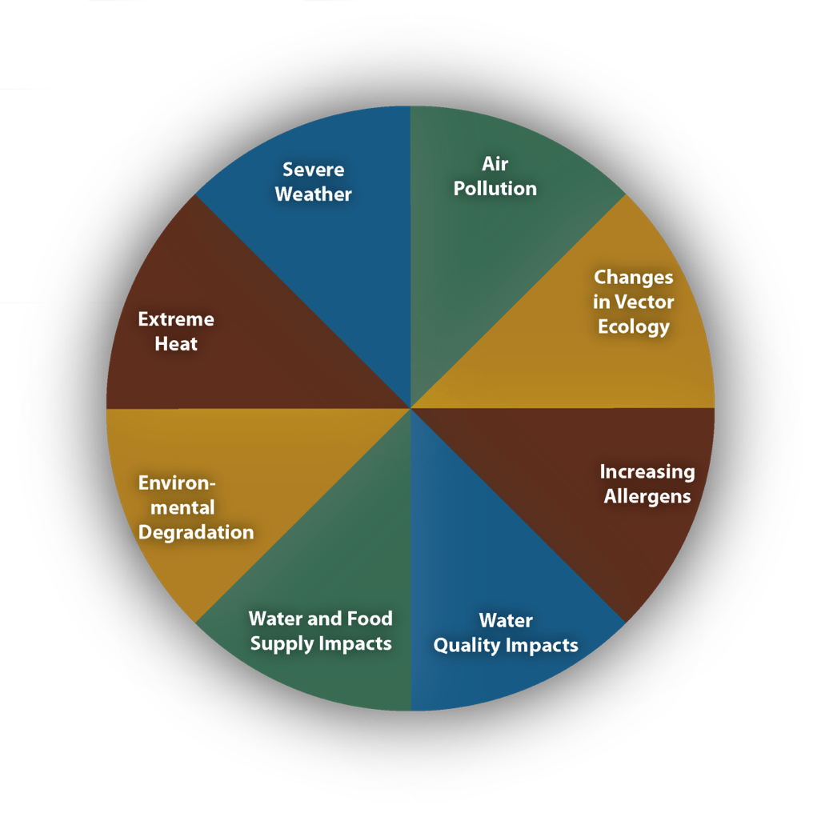
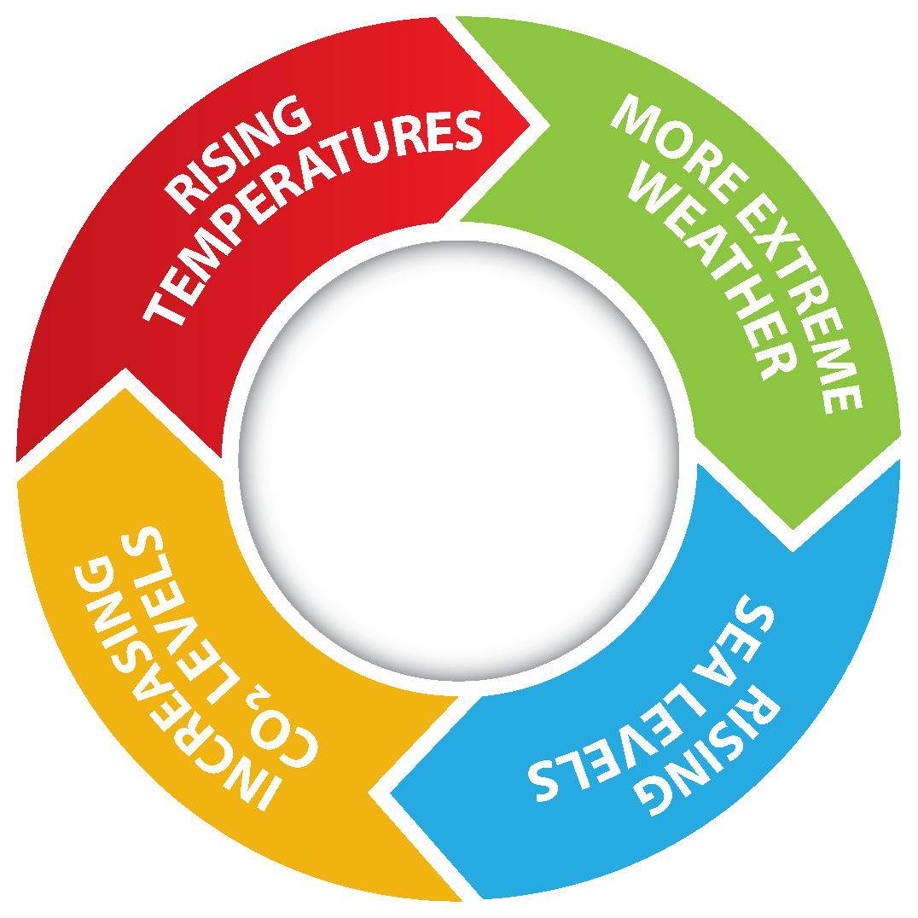
Notes:
Source: CDC
Climate change impacts a wide-range of health outcomes. This slide illustrates the most significant climate change impacts (rising temperatures, more extreme weather, rising sea levels, and increasing carbon dioxide levels), their effect on exposures, and the subsequent health outcomes that can result from these changes in exposures.

Slide 3
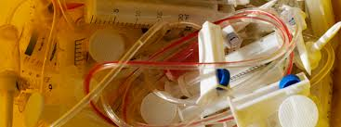
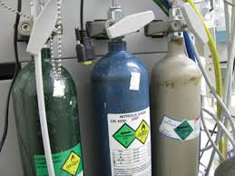
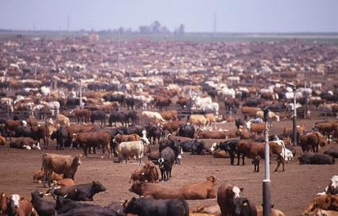
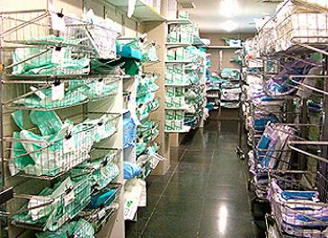


What does climate change have to do with health care?
Health care is part of the problem
8% U.S. GHG
>2 million tons of waste per year
Anesthesia gas
Food systems
Supply chain
Thanks for use of the slide
Notes:
Health care wields a large footprint: represents 8% of US greenhouse gas emissions, produces over 2 million tons of waste per year, emits anesthetic gas into the air, and has an enormous footprint in its supply chain.

Slide 4




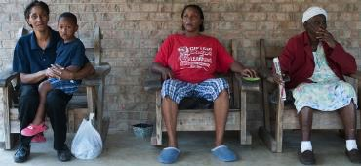


What does climate change have to do with health care?
Health care treats climate-health issues
    More illness
      Respiratory
      Cardiac
      Infection
      Heat-related illness
    More emergencies
      Trauma
      Flooding
      Fires
    More exposures, more violence
      Especially poor and vulnerable
Thanks for use of the slide
Notes:
Health care is already seeing a spike in climate and health issues: greater number of respiratory, asthma, and allergen cases are coming through, and of course – extreme weather events create more cases.

Slide 5

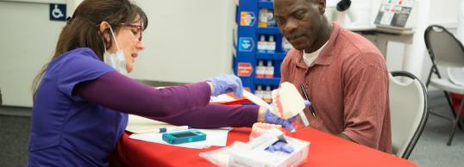

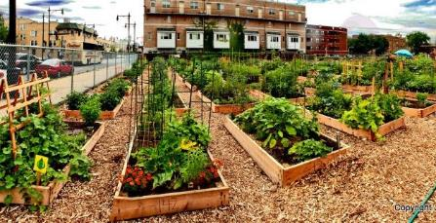
What does climate change have to do with health care?
Health care can advance public and community health
Health education
Screenings and prevention
Livable communities
Affordable and safe housing
Food security
Sustainable transportation
Thanks for use of the slide
Notes:
But health care has an important opportunity to use their trusted voice to advance public and community health.

Slide 6

What does climate change have to do with health care?
By working to mitigate (reduce) climate change and to prepare for unavoidable changes, health care can:
Deliver better care, meeting health outcomes goals
Create healthy communities, preventing poor health in the first place
Educate clinicians and the public
Meet quadruple aim
Save money
Thanks for use of the slide
Notes:
This is a win-win for health care.

Slide 7
Climate change brings significant health risks
Notes:
For a health system caring for its community, this brings significant health risks.

Slide 8
Opportunities in community health needs assessment
Collect data and prioritize local health needs climate impacts and health risks in future
Develop implementation strategies climate co-benefits
Implement and evaluate
Notes:
However, those health risks also brings various opportunities, and the community health needs assessment process is a great place to explore those opportunities.

Slide 9

Increased recognition of climate as a community health need
2016 KP CHNA prioritized community health needs (preliminary) | Total
Obesity/HEAL/diabetes | 39
Behavioral health (Mental health, substance abuse/tobacco) | 39
Access to care | 39
Economic security | 31
Violence/injury prevention | 30
CVD/stroke | 22
Asthma | 22
Cancers | 21
Oral health | 19
HIV/AIDS/STIs | 19
Maternal and infant health | 15
Climate and health | 14
Housing | 13
Transportation | 11
Education | 7
CHNA health needs that can be addressed through co-benefit strategies
Notes:
We’re seeing an increased uptake of health systems looking at climate and health issues while evaluating community health needs. This example is a scorecard from Kaiser Permanente which categorizes the various areas with opportunities to use the community health needs assessments to identify climate co-benefit strategies.

Slide 10
Notes:
The climate scorecard is a great tool you can use to evaluate existing and/or new community benefit activities for co-benefits.

Slide 11

Activities with climate co-benefits organized by health needs
The report focuses on the common health priorities:
Obesity, diabetes, cardiovascular risks (community benefit strategies can address multiple risks)
Asthma and respiratory problems
Access to health care
Substance abuse
Notes:
To take a deep dive into the opportunities, review the “Leveraging Hospital Community Benefit Activities to Address Climate Change and Environmental Risks” report which focuses on the most common health priorities that end up identified through the CHNA process.

Slide 12
Obesity/diabetes/cardiovascular risks:
Climate-friendly projects
Notes:
Here’s an example of one of the common areas and some of the different climate and environmental benefits. This also helps identify potential partners externally and/or internally.

Slide 13


Obesity community benefit activities with climate co-benefits
Notes:
Promoting plant-based diets reduces greenhouse gas emissions and can combat obesity with healthier food choices in current community benefit work.
Supporting local green growers or offer more plant-based options in your cafeteria. One example of this is with Cleveland Clinic and University Hospitals in Cleveland, Ohio. They work through an organization called Evergreen Cooperatives, which they support through various ways, including through procurement of all of their lettuce through their hydroponic garden. Other hospitals can leverage in-house expertise to share learnings with community partners.
Promoting tap water as an alternative to sugar-sweetened drinks with local employers, schools, and others reduces obesity risks and energy use in bottling drinks.

Slide 14


Asthma community benefit activities with climate co-benefits
Notes:
At Rutland Medical Center in Vermont, they’re doing home repairs with energy upgrades and health coaching to reduce asthma symptoms and ED visits.
At University Hospital and Cleveland Clinic, they’ve invested in Evergreen Cooperatives, a local clean energy businesses or community solar to reduce air pollution and create local jobs.

Slide 15


Access to care initiatives with climate co-Benefits
Notes:
Community health centers and telemedicine can reduce patient transit and transit emissions.
At Seattle Children’s Hospital, they provide support for community public transit, shuttle buses, and bike paths, which can reduce transit emissions among residents not just patients.

Slide 16
Climate community indicators summary – Southern California Hospital sample
Notes:
While community health needs assessments tend to focus on current conditions, data looks to the future. We have an Excel workbook available to calculate future impacts, which could be an effective role for environmental sustainability staff.

Slide 17

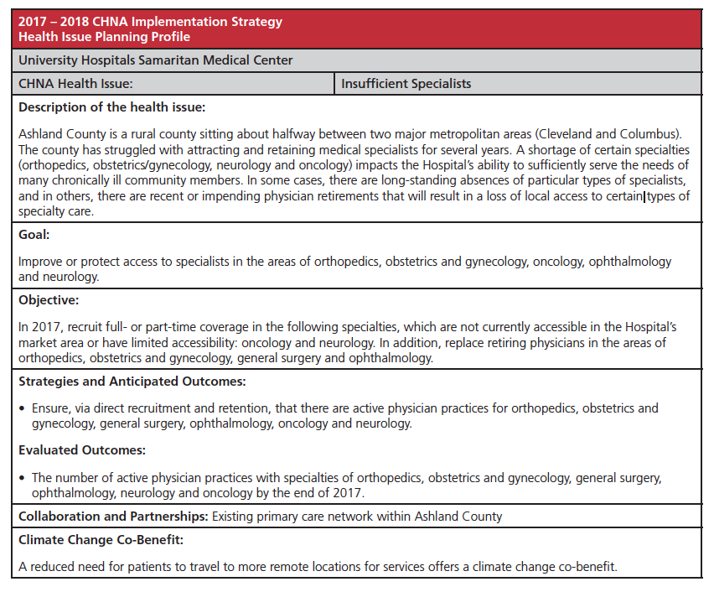
UH incorporates climate in community health needs assessment
Notes:
UH Samaritan incorporated climate and health language in its latest assessment and identified climate co-benefit in its community health needs assessment implementation strategy.

Slide 18



Providence St. Joseph Health: Climate Smart Missoula
Arose out of municipality climate planning
Measurable benchmarks/goals
Advance community wide planning
Strong health voice
Summer Smart Missoula
Thanks for use of the slide
Notes:
Summer Smart Missoula
Identify vulnerable neighborhoods
Safety education about heat and smoke
Clean air spaces
Solar charging stations
Filters, fans
Climate and Health Summit

Slide 19

Inova: A different approach
Notes:
Inova thought about how to educate the community through patients. These brochures are available in Inova Health waiting rooms for parents to take, read, and understand the climate and health impacts. Inova Fair Oaks also incorporated climate and health language into their community health needs assessment implementation plan.

Slide 20
Helping you persuade, provide examples, and calculate impacts
Get Started Guide
Community Benefits Climate Change Scorecard template and sample
Leveraging Hospital Community Benefit Activities to Address Climate Change and Environmental Risks
Spreadsheet to calculate climate change community health indicators
Sample text for community health needs assessment and implementation strategies identifying climate as a health risk and recognizing opportunities for co-benefits
And more on the Practice Greenhealth website
Notes:
Identify relevant community genefit staff, and begin the process of outreach.
Review the Get Started Guide and follow the recommended steps.
Reach out to your Practice Greenhealth member engagement liaison for additional support.

Slide 21
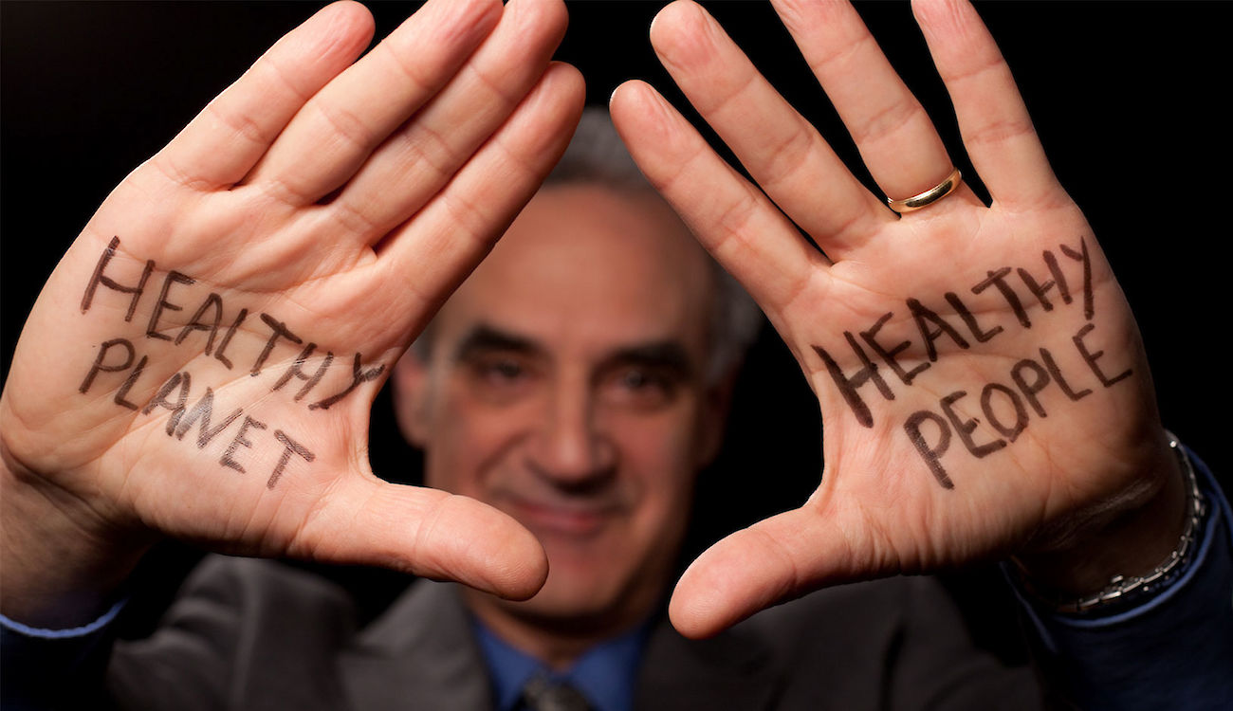
Thank you
Notes:
For more information, please contact Lauren Koch at lkoch@hcwh.org.

