Slide 1
Setting a Greenhouse Gas Goal
[ADD HEALTH SYSTEM NAME]
Template presentation for
leadership
Notes:
Please see the Practice Greenhealth Greenhouse Gas Reduction Toolkit’s “Leadership Engagement and Goal Setting” section for additional guidance on how to make the pitch, which will help inform this slide deck. These slides are meant to be tailored to your hospital leadership audience - take what you need, delete what you don’t. See slide 3 for further instructions, and be sure to delete that slide before your presentation.

Slide 2
Today’s agenda
1
3
Climate change and health background
Mission alignment
2
4
Why set a goal
Making other commitments

Slide 3
How to use this presentation
This presentation was created to accompany, not replace Practice Greenhealth’s Greenhouse Gas Reduction Toolkit.
This slide deck is meant to be tailored to your hospital audience. Keep the slides that make sense, and delete those that don’t work for you.
Talking points are included in the notes section.
DELETE THIS SLIDE BEFORE PRESENTING

Slide 4
Climate change and health background

Slide 5
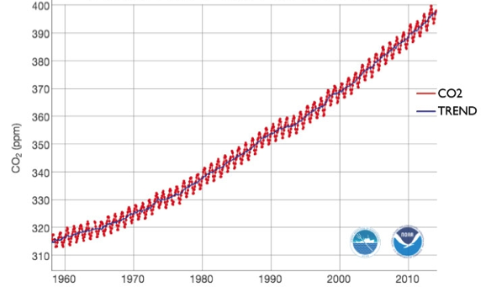
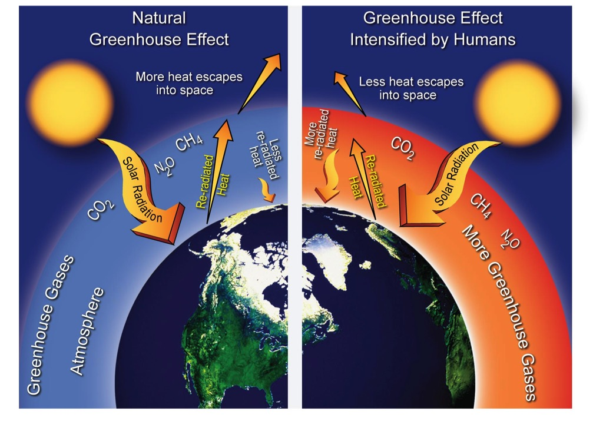
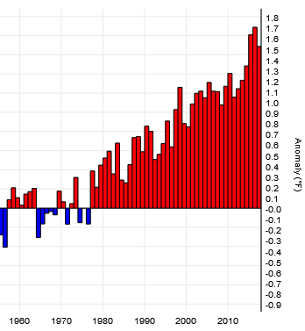
Greenhouse gases
Mauna Loa Observatory
Monthly Average Carbon Dioxide
(1960-2015)
Global temperature deviations from mean (1880-2016)
Courtesy of the National Climate Assessment (2012)
Notes:
Humans began burning fossil fuels like coal, oil, and natural gas at the end of the 19th century.
Burning fossil fuels releases greenhouse gases into earth’s atmosphere – the most prominent of which is carbon dioxide.
When greenhouse gases build up in earth’s atmosphere, they trap in the sun’s heat.
Over time, this trapped heat has led to an increase in the average global temperature. The more greenhouse gases we have in our atmosphere, the warmer our planet gets.
Some places on the planet have higher increases in heat than others, such as the North and South Poles.
As the poles get warmer, large amounts of ice melts into the oceans.
These global changes in temperature and sea levels lead to a multitude of health effects.

Slide 6
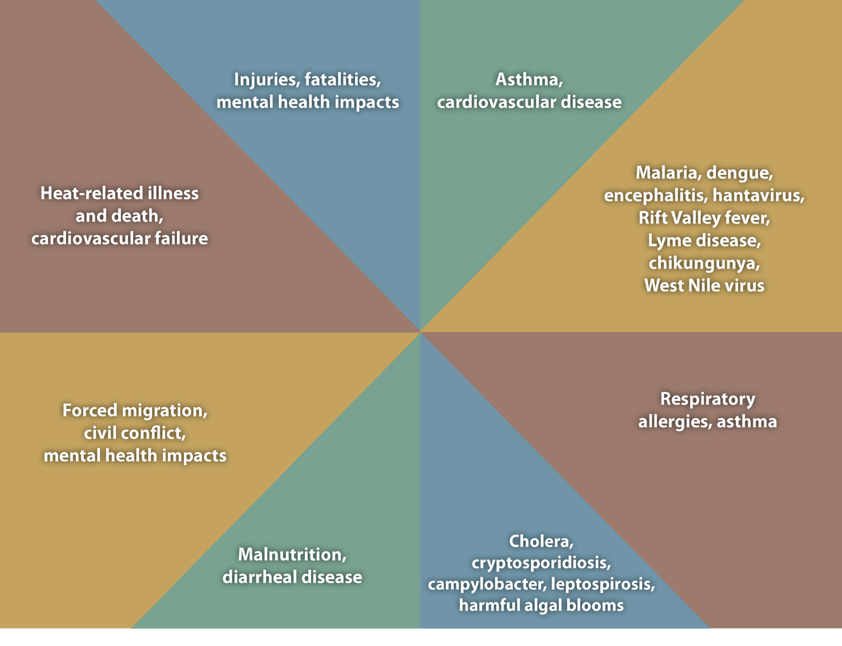
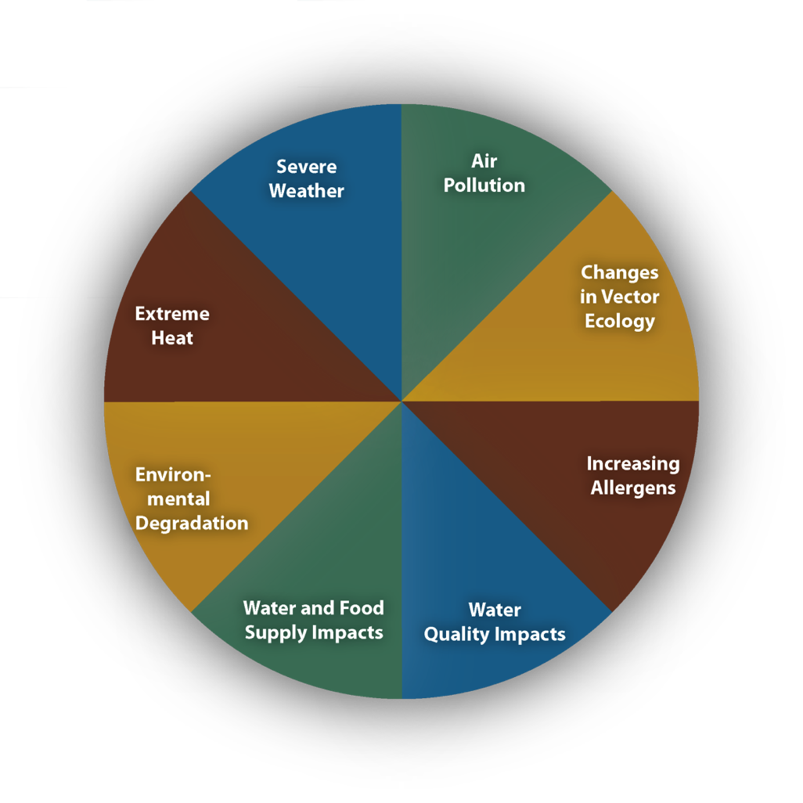
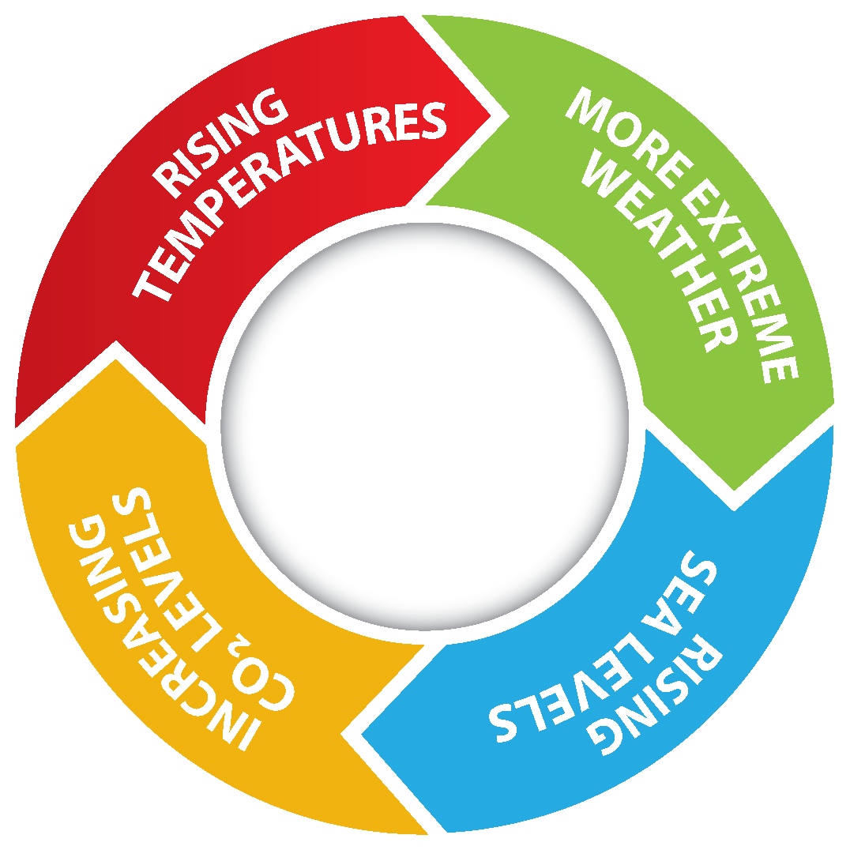
Notes:
This image is from the Centers for Disease Control.
Many state, national, and global health agencies have highlighted the health impacts of climate change, such as the American Public Health Association and the World Health Organization. In fact, The Lancet Commission identified climate change as the No. 1 public health threat of the 21st century.
The center ring shows the cycle of increasing carbon dioxide, which leads to rising temperatures, more extreme weather, and rising sea levels.
The next ring highlights eight primary global effects that occur due to warmer temperatures, extremes in weather, and higher sea levels, such as extreme heat, air pollution, increasing allergens, and impacts on water and food supply, among others.
Take a moment to read some of the specific health threats humans are now faced with due to climate change around the outer edge of the diagram.
We all care for people who are already experiencing these health impacts. As you can imagine, some people are more at risk than others, such as:
Infants and young children
The elderly
People living in poverty or those who are homeless
People with chronic physical or mental conditions
Outdoor workers/players

Slide 7
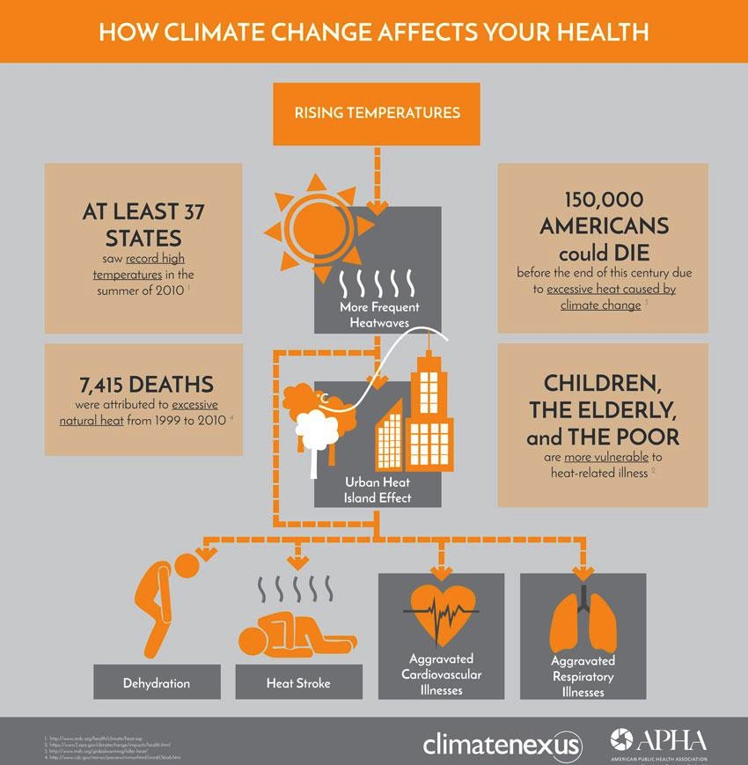
Extreme heat
More very hot days, higher humidity, longer & hotter heat waves
14.5 million additional Americans exposed to heat waves annually (2000-2016) than in past years
Illness and death from heat stroke and dehydration
Longer seasons for allergens
Notes:
Specific figures (share one or two of these based on your audience):
Vulnerable populations: those with chronic conditions (cardiovascular, respiratory), outdoor workers/players, people without air conditioning, pregnant women, people taking certain medications
“Between 2000 and 2016, the average number of Americans exposed to heat wave events annually increased by an average of 14.5 million, compared to the reference period (1986-2008). 2011 was a year of extremely high risk, with nearly 130 million additional Americans exposed to heat waves.” (Lancet, 2017).
It’s the leading cause of illness and death in young athletes. Each year, 9,000 high-school aged athletes are treated. (Medical Society Consortium, 2017).
Heat doesn’t just affect the frail, ill, or elderly. In fact, 1/3 of all heat-related ER visits in the U.S. are among young men. (Medical Society Consortium, 2017).
Football players are 11 times more likely to experience illness from the heat than all other high school athletes combined. (Medical Society Consortium, 2017).

Slide 8
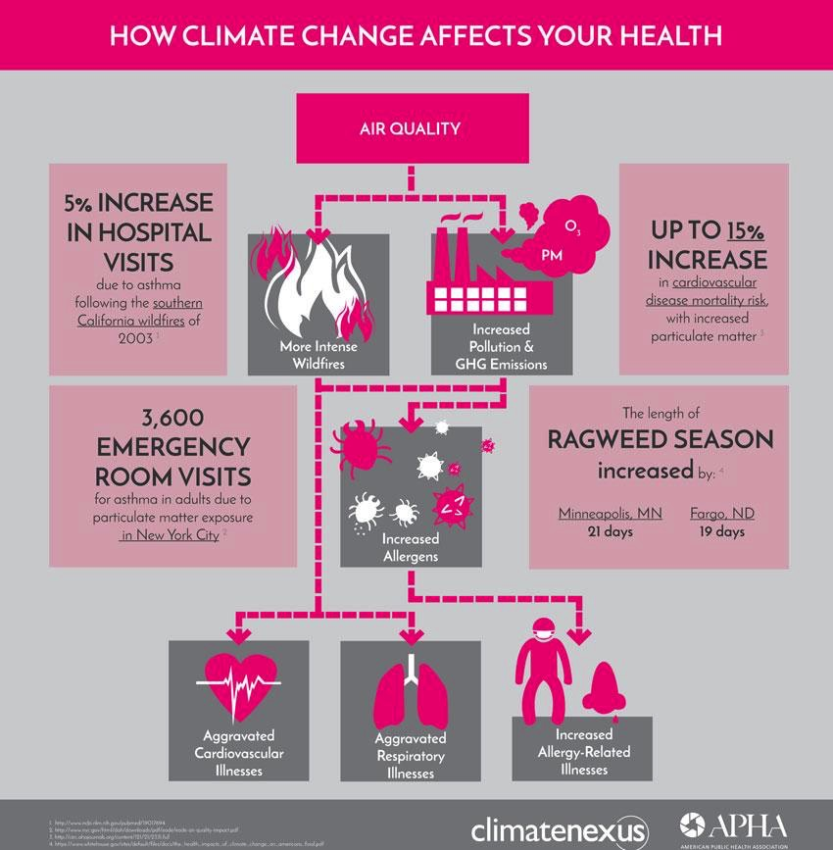
Air pollution
7 million annual deaths worldwide
Heat increases wildfires, smog, and pollen
Humidity and flooding leads to indoor mold growth
Exacerbations in asthma and allergies
Notes:
Specific figures (share one or two of these based on your audience):
Outdoor air pollution from the burning of fossil fuels causes 7 million deaths annually - more than all of the deaths of TB, malaria, and AIDS combined (World Health Organization, 2014).
Most vulnerable: people with pre-existing respiratory conditions (asthma, COPD) and cardiovascular disease (Medical Society Consortium, 2017).
Ragweed seasons have increased by 11-27 days a year throughout the U.S. (National Climate Assessment, 2014).

Slide 9
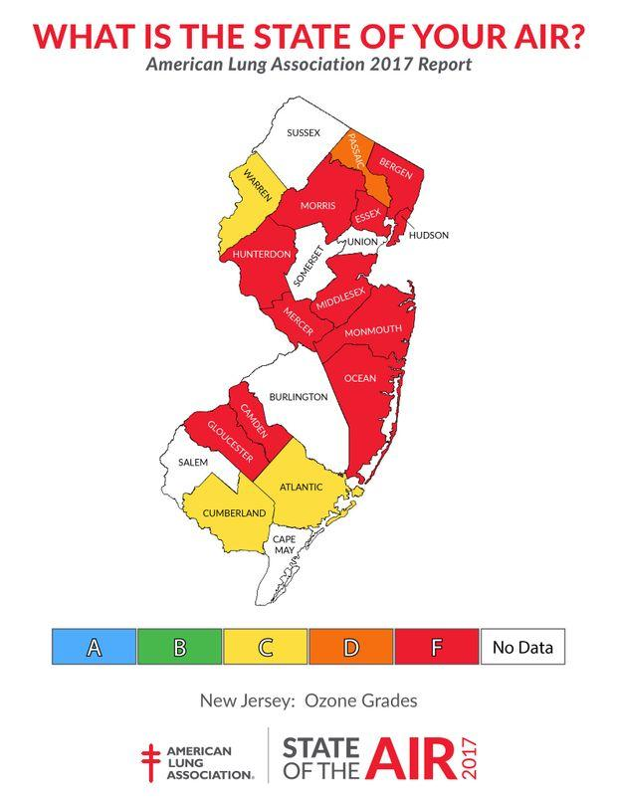
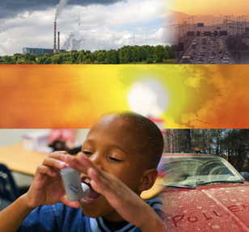
Air pollution – paying with our health [UPDATE FOR YOUR REGION WITH LINK FROM NOTES]
Notes:
Access your state’s information and add it to the slide: http://www.lung.org/local-content/california/our-initiatives/state-of-the-air/2018/state-of-the-air-2018.html
When it comes to dirty energy sources, it’s not as “cheap” as we thought…we’re literally paying with our health.
A 2015 paper from the International Monetary Fund found that fossil fuels are subsidized at $5.3 trillion globally, equivalent to about 6.5% of global GDP, greater than the health of all the world's governments. Just over half of this figure consists of the fossil fuel industry’s externalities, or the money governments are forced to spend treating the victims of air pollution and the income lost because of the resulting ill health and premature deaths. To show what is possible with energy subsidy reform, the IMF researchers calculated that ending these subsidies would slash the number of premature deaths from outdoor air pollution by 55% – about 1.6 million lives a year.* Coal would account for a 93% share of this reduction. It would also significantly reduce health care costs and reduce C02 emissions by 20%.

Slide 10
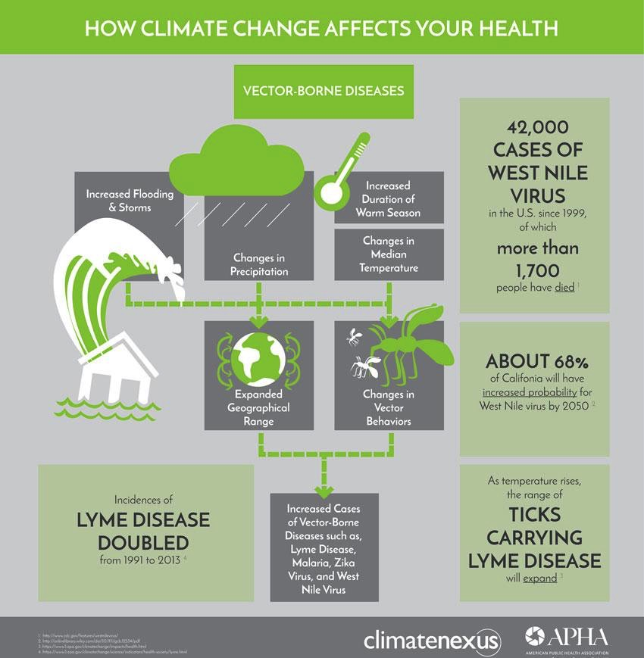
Changes in ecology
Changes in range, lifespan, virulence, and population
Mosquitoes: West Nile virus, malaria, & zika virus
Ticks: Lyme disease
Extreme weather leads to breeding grounds
Notes:
Specific figures (share one or two of these based on your audience):
Everyone is affected, but people who spend time outdoors and pregnant women (Zika virus) are most vulnerable.
Malaria leads to more than 400,000 deaths annually (World Health Organization, 2017).
Changes in vector ecology (climate strongly influences mosquito habitats and activity): Lyme cases have more than doubled since the 1990s, and the number of counties that are now deemed high risk for Lyme has increased by more than 320% in the same period. (Environmental Protection Agency, 2017)
The geographic range of ticks in the U.S. has increased over 50% since 1998. (Medical Society Consortium, 2017).

Slide 11
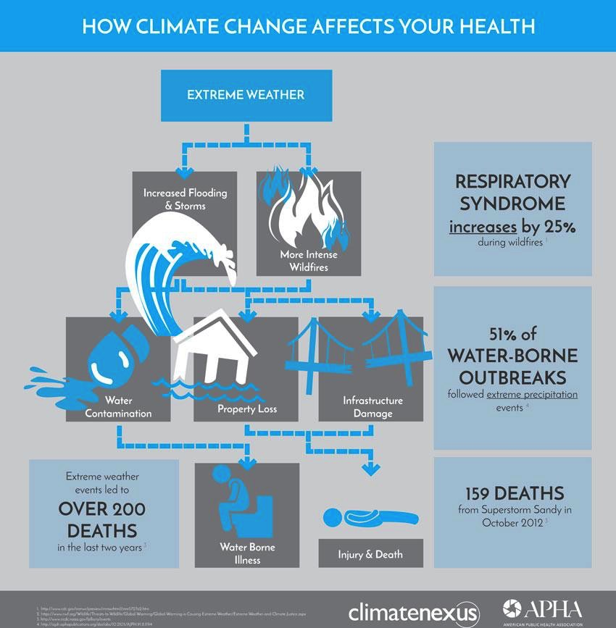
Severe weather
More frequent and severe rains, floods, droughts, fires, and major storms
Housing displacement
Decreased access to health services and medications
Particularly damaging to mental health
Notes:
Specific figures (share one or two of these based on your audience):
Everyone is affected, but the most vulnerable are children, older adults, people in poverty, people with disabilities. (Medical Society Consortium, 2017).
Destruction of infrastructure from severe weather leads to equipment and supply shortages. For example, Hurricane Maria in Puerto Rico led to medication and medical supply shortages around the world.
Changing rainfall and flooding decreases security in water and food supply, which leads to 3.1 million deaths annually. (World Health Organization, 2017)

Slide 12
Mental health
Depression, anxiety, anger, hopelessness, PTSD, uncertainty – and the list goes on
Familial, financial, and societal impacts are often unquantifiable and difficult to articulate
Example: 215,000 Puerto Ricans fled to Florida after Hurricane Maria
Climate change expected to lead to 200 million more forced migrations by 2050, which contribute to civil conflict
Notes:
Physical health impacts of climate change also have implications for mental health, such as when individuals struggle with disease related to climate change or when they lose physical infrastructure such as a home or business.
Most vulnerable: Children, the elderly, pregnant women, people with pre-existing mental health conditions, those in poverty, homeless, first responders (Medical Society Consortium, 2017)
U.N. International Organization for Migration estimates an additional 200 million migrants by mid-century. This applies to the United States as well. For instance, 215,000 Puerto Ricans have arrived in Florida since Hurricane Maria. (CBSMiami, 2017) See article titled “How to save a town from rising waters” for a story that outlines the first American government-financed community resettlement.
International example: Syrian drought → forced migration to urban areas → larger populations living in cities causes resource strain → civil unrest → refugees
Health professionals will also feel the impacts:
Forefront of emergent care (crisis response)
Migration leads to changing patient population with more complex health needs (language, insurance, health histories, trauma, etc.)
Limited resources with greater patient needs
See resource titled “Mental health and our changing climate: Impacts, implications and guidance” (Climate for Health, 2017).

Slide 13
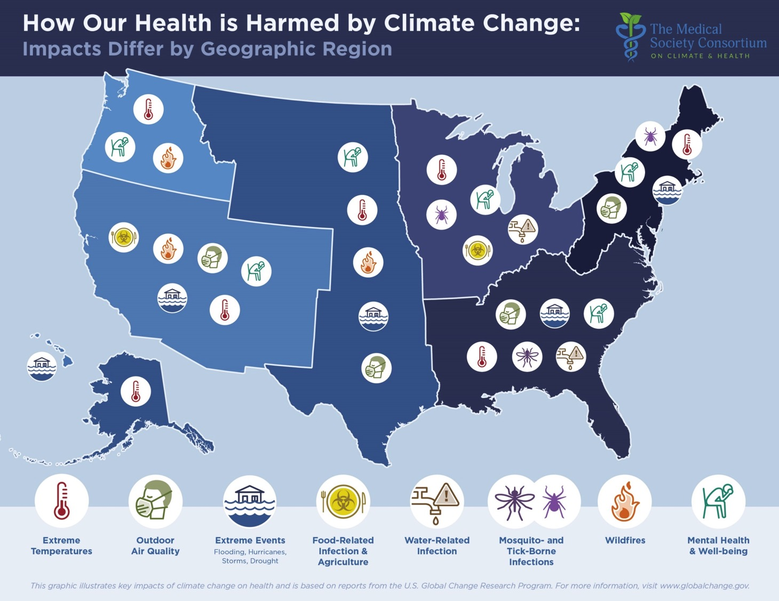
Notes:
Health impacts of climate change vary by region. Sharing specific stories or examples of how our health is harmed by climate change makes the issue more “real” for many people. See this image and the links below for further information about specific impacts in your area:
Climate Central “States of Change:” Stories of climate change from close to home - http://www.climatecentral.org/states-of-change#/nation
US EPA “Climate Change Impacts by State” factsheets (as of January 2017) - https://19january2017snapshot.epa.gov/climate-impacts/climate-change-impacts-state_.html
National Climate Assessment: Exploration of regional impacts - https://nca2014.globalchange.gov/report#section-1948
Natural Resources Defense Council “Health Risks and Climate Change:” State-specific fact sheets for ILLINOIS, IOWA, MICHIGAN, MISSOURI, OHIO, PENNSYLVANIA, AND VIRGINA - https://www.nrdc.org/resources/health-risks-and-climate-change
(Image source: The Medical Society Consortium on Climate & Health - https://medsocietiesforclimatehealth.org/reports/medical-alert/)

Slide 14
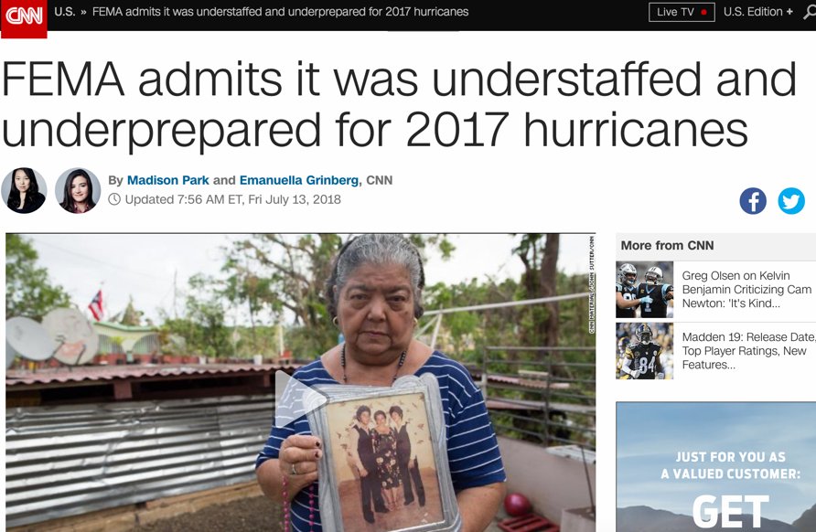
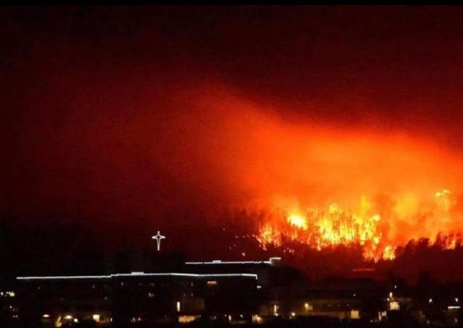
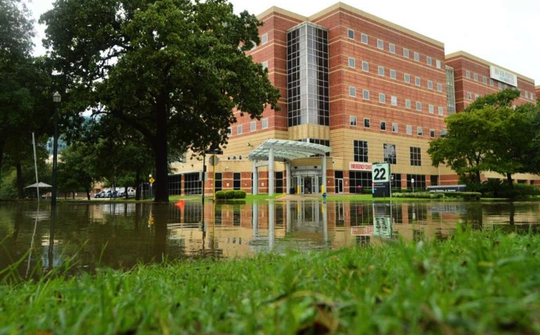
Hospital climate action is urgent
Notes:
Update this slide with imagery for climate and health impacts most relevant in your region.

Slide 15
How this aligns with strategic priorities

Slide 16
Alignment with strategic priorities
[Add your hospital / health system’s mission, values, priorities, and alignment with climate mitigation work]
Notes:
See the Practice Greenhealth Greenhouse Gas Reduction Toolkit section on “Leadership Engagement and Goal Setting” for additional guidance on how to make the pitch, which will help inform this slide deck.

Slide 17
Successes to date
[Add your hospital / health system’s successes]
Notes:
See the Practice Greenhealth Greenhouse Gas Reduction Toolkit section on “Leadership Engagement and Goal Setting” for additional guidance on how to make the pitch, which will help inform this slide deck.

Slide 18
Energy progress to date
[Add your hospital / health system’s EUI and renewable energy data]
Notes:
Work with your Member Engagement Manager at Practice Greenhealth to compare median and 90th percentile EUI and renewable energy data to compare where your hospital / health system is at in terms on progress.

Slide 19
Setting a goal

Slide 20
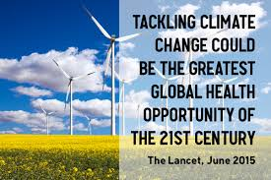
Need for action
Notes:
Earlier in the presentation, we discussed why action is urgent, and international and U.S.-based organizations are repeating this message.
The Lancet released its 2015 commission that “Tackling climate change could be the greatest global health opportunity of the 21st century.” https://www.thelancet.com/journals/lancet/article/PIIS0140-6736(15)60931-X/abstract
The American Hospital Association’s Sustainability Roadmap for hospitals even has a recommendation for advanced hospitals to target carbon neutral by 2050.
And finally, the Medical Society Consortium on Climate and Health has organized over 20 medical associations that have recognized climate and health as an issue for patients and for the health sector.
Medical societies that are urging climate action:
American College of Physicians (ACP)
American Academy of Family Physicians (AAFP)
American Academy of Pediatrics (AAP)
American College of Obstetricians and Gynecologists (ACOG)
National Medical Association (NMA)
American Academy of Allergy Asthma & Immunology (AAAAI)
American College of Preventive Medicine (ACPM)
American Podiatric Medical Association (APMA)
American Geriatrics Society (AGS)
Society of General Internal Medicine (SGIM)
Academy of Integrative Health and Medicine (AIHM)
American Association of Community Psychiatrists (AACP)
California Chapter of American College of Emergency Physicians
American Telemedicine Association (ATA)
Society of Gynecologic Oncology (SGO)
American Medical Women’s Association (AMWA)
American College of Lifestyle Medicine (ACLM)
American Medical Association (AMA)
American Psychiatric Association (APA)
American College of Osteopathic Internists (ACOI)
American Academy of Dermatology (AAD)

Slide 21
Health care contributes to climate change
Energy use for heating, cooling, lighting, & water use
10% of U.S. greenhouse gas emissions
Waste anesthetic gases
Waste hauling, treatment, & landfill gases
Meat production & food transport
Fleet vehicles
Employee commutes
Supplies & materials
Notes:
Health care is contributing to - and impacted by - greenhouse gas emissions.
The health care industry contributes almost 10% of U.S. greenhouse gas emissions. (Eckelman & Sherman, 2016)
Typical areas of largest impact are highlighted in the gray clouds. (Health Care Without Harm)
Hospitals are the second most energy-intensive facilities in the country and use 2.5 times more energy per square foot than other commercial buildings.
Hospitals are ranked as the third most water-intensive public buildings (after senior care facilities and hotels), using an average of 570 gallons per staffed bed per day. Water is also a major contributor to greenhouse gas emissions because of the energy needed to distribute, treat, and heat it.
Hospitals serve a lot of food to their staff, patients, and visitors. Since an estimated 14.5 percent of global greenhouse gas emissions come from the livestock sector hospitals can make a big difference by serving less meat.
U.S. hospitals generate 29 pounds of waste per patient day in the hospital. But the manufacturing process and transportation of the products purchased by U.S. hospitals also creates 32 pounds of waste for every pound of product manufactured.

Slide 22
Scopes defined
Notes:
All of the health system goals set to date are for Scope 1 and 2 only.
Scope 1:
Stationary combustion of fuels (e.g. boilers, generators, onsite incinerators)
Mobile fuel combustion by fleet vehicles
Refrigerants
Waste anesthetic gas
Scope 2:
Purchased electricity
Purchased steam or hot water
Purchased chilled water
Scope 3:
Fuel and energy-related activities (not in 1 or 2)
Transportation and distribution of products
Purchased goods or services
Capital goods
Disposal of waste generated in operations
Employee business travel
Employee commute
End of life treatment of sold products
Leased assets

Slide 23
Health sector is making progress
 | Carbon neutral by 2027 (Scopes 1 and 2 only)
 | NYC Carbon Challenge: Reduce greenhouse gas emissions 50% by 2025 (Scopes 1 and 2 energy only)
 | 100% energy independence from grid
 | Carbon neutral by 2020 (Scopes 1 and 2 only) Carbon positive by 2025
 | 100% renewable electricity
 | 25% by 2020 (Scopes 1 and 2 energy only) 100% by 2050
Notes:
These are just a few examples of the health system GHG reduction goals that are currently in place. Here are a few others:
Dartmouth Hitchcock: 25% reduction by 2020 (Scopes 1 and 2 only)
Dignity Health: 40% reduction by 2020 (Scopes 1 and 2 only)
Montefiore Health System: 50% reduction by 2025 (electricity only)
Providence St. Joseph Health: 30% reduction by 2025, 100% by 2040 (Scopes 1 and 2 only)
Sutter Health: 50% by 2025 and 80% by 2030 with a 2014 baseline (Scopes 1 and 2 only)
University of California Health: Carbon neutral by 2025 (Scopes 1 and 2 only)
Virginia Mason Memorial Yakima: Carbon neutral by 2025 (Scopes 1 and 2 only)

Slide 24
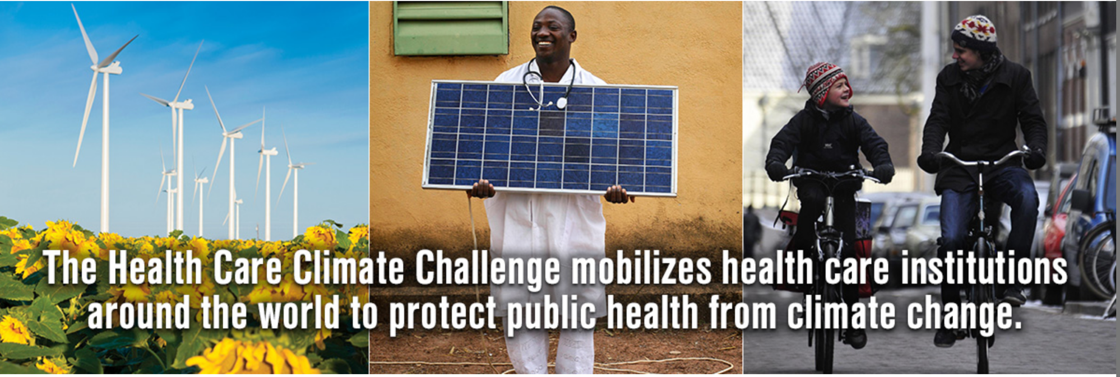
Health Care Climate Challenge
178 institutions across the globe representing the interests of 17,000 hospitals and health facilities have already committed to this challenge
Notes:
What is the Climate Challenge? Committing to progress in each of these three pillars:
Mitigation – Reduce health care’s own carbon footprint.
Resilience – Prepare for the impacts of extreme weather and the shifting burden of disease.
Leadership – Educate staff and the public about climate and health and promote policies to protect public health from climate change.
Join 178 institutions across the globe representing the interests of 17,000 hospitals and health facilities

Slide 25
Action by other sectors
Higher education:
President’s Climate Commitment
Business:
90% of Fortune 500 companies report to the Carbon Disclosure Project using the GHG Protocol standard
Power Forward: 48% of Fortune 500 companies have a climate goal. Annual emission reductions from these efforts are the equivalent to taking 45 coal-fired power plants offline for a year.
145 companies committed to 100% renewable electricity
States, cities:
California – SB 100
Boston – Green Ribbon Commission
New York City – Mayors Carbon Challenge
Notes:
This isn’t just the health care sector that is taking action – in fact, the health sector is lagging in some respects.
Universities are also taking notice. 13 prestigious universities came together to form the University Climate Change Coalition and create a roadmap for university action on climate change. Their aim is to “prototype a collaborative model designed to help local communities achieve their climate goals and accelerate the transition to a low-carbon future.”
The Presidents’ Climate Leadership Commitment has been signed by hundreds of college presidents and chancellors, and nearly 350 universities have signed onto the We Are Still In pledge.
Corporations/Businesses:
An analysis of 600 companies showed that those experiencing the impacts to their business are the ones taking action.
9 out of 10 Fortune 500 companies reporting to the Carbon Disclosure Project use the GHG Protocol standard to set their goals and report on progress, and they are making a real difference:
The reported annual emission reductions from these companies are equivalent to taking 45 coal-fired power plants offline for one year, according to Power Forward 3.0.
States/Cities:
Boston’s Green Ribbon Commission is a task force set up to help achieve the city-wide target of carbon neutrality by 2050 and includes a health care working group to engage Boston area hospitals, which include over 65 buildings with 24 million square feet. Partners HealthCare and Boston Medical Center are aligned with the carbon neutral goal by 2050.
New York City has set up a city-wide Carbon Challenge, and similar to Boston, has a hospital work group to help support their journey to a 50 percent reduction goal by 2025. There are a number of other cities and states that have set GHG reduction goals.
California has some of the most ambitious GHG reduction goals in the country. Building a Climate-Smart Health Care System in California presents recommendations for hospitals and policymakers to support the health care sector, which makes up 13 percent of the state’s GDP, in contributing to the state’s reduction goals. They have just passed SB 100 which aims to take the state to 100% renewable energy and carbon neutral by 2045.
A report from the World Wildlife Fund, Measuring up 2015: How US Cities are Accelerating Progress Towards National Climate Goals, reviews 34 cities that have at least committed a goal of reducing GHG emissions 80 percent by 2050. The Carbon Disclosure Project has a database that can be filtered by countries to see all the cities that have made any type of GHG reduction goal, and Arup and C40 aggregated city climate commitments in this report.

Slide 26
Suggested goal
Notes:
Use this slide to add the suggested goal(s) for your hospital / health system. See the Practice Greenhealth Greenhouse Gas Toolkit section on “Leadership Engagement and Goal Setting” for additional guidance on goal options.

Slide 27
How to take action
Set a greenhouse gas goal for the hospital / health system
Reduce OR energy use & waste
Invest in renewable energy
Educate your community
Reduce, reuse, recycle
Choose local, sustainable foods & reduce food waste
Include climate risks in emergency preparedness plans
Carpool, bike, walk, or take public transport
Notes:
Ultimately this is about figuring out how to take action. A goal is one step along that journey, but it’s just one step. This will take a holistic approach of many different efforts inside and outside of the hospital. After setting a goal, the next step will be to work together on a process for including key stakeholders to develop a plan for meeting the goal(s).
Choose 1-3 of the green bubbles as key areas to make progress in and their respective stakeholders.

Slide 28
Questions?

