Slide 1
Climate and Health
December 2015
Materials for Practice Greenhealth members ONLY

Slide 2
Table of Contents
Background:
Climate Change Science
Health Impacts of Climate Change and Energy Sources
Solutions: Mitigation
Energy Efficiency
Renewables
Greenhouse Gas Emissions Benchmarking/Reduction
Solutions: Resilience
Resilience Toolkit
Solutions: Leadership
The Health Care Sector’s Responsibility
HCWH Health Care Climate Council
Notes:
This slide deck is intended to give you a variety of slides that you can pull from, depending on your need. The slide deck goes through the background first: climate change science and health impacts of climate change and different energy sources. Then it reviews the three pillars of climate health: mitigation, resilience, and leadership, along with tools for each of those solutions.

Slide 3
Background
Climate Change Science
Health Impacts of Climate Change
Health Impacts of Energy Sources
Notes:
These slides give you the background you need to frame up the discussion – what climate change is, the health impacts of climate change, and the health impact of the energy sources that hospitals and health organizations most often use.

Slide 4
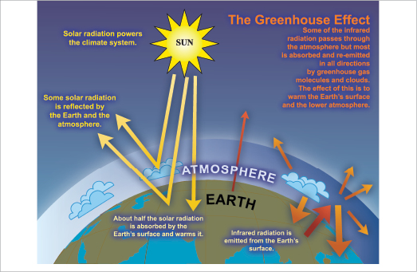
The Greenhouse Effect
Notes:
Source: https://www.ipcc.ch/publications_and_data/ar4/wg1/en/faq-1-3.html
The Sun powers Earth’s climate, radiating energy at very short wavelengths, predominately in the visible or near-visible (e.g., ultraviolet) part of the spectrum. Roughly one-third of the solar energy that reaches the top of Earth’s atmosphere is reflected directly back to space. The remaining two-thirds is absorbed by the surface and, to a lesser extent, by the atmosphere. To balance the absorbed incoming energy, the Earth must, on average, radiate the same amount of energy back to space. Because the Earth is much colder than the Sun, it radiates at much longer wavelengths, primarily in the infrared part of the spectrum (see Figure 1). Much of this thermal radiation emitted by the land and ocean is absorbed by the atmosphere, including clouds, and reradiated back to Earth. This is called the greenhouse effect. The glass walls in a greenhouse reduce airflow and increase the temperature of the air inside. Analogously, but through a different physical process, the Earth’s greenhouse effect warms the surface of the planet. Without the natural greenhouse effect, the average temperature at Earth’s surface would be below the freezing point of water. Thus, Earth’s natural greenhouse effect makes life as we know it possible. However, human activities, primarily the burning of fossil fuels and clearing of forests, have greatly intensified the natural greenhouse effect, causing global warming.

Slide 5
NASA – carbon dioxide levels
Notes:
Source: http://climate.nasa.gov/evidence/
The Earth's climate has changed throughout history. Just in the last 650,000 years there have been seven cycles of glacial advance and retreat, with the abrupt end of the last ice age about 7,000 years ago marking the beginning of the modern climate era — and of human civilization. Most of these climate changes are attributed to very small variations in Earth’s orbit that change the amount of solar energy our planet receives.
The current warming trend is of particular significance because most of it is very likely human-induced and proceeding at a rate that is unprecedented in the past 1,300 years.¹

Slide 6
NOAA links CO2 Concentration and Temperature
Notes:
Source: https://www.ncdc.noaa.gov/indicators/
Global average temperature is one of the most-cited indicators of global climate change, and shows an increase of approximately 1.4°F since the early 20th Century. The global surface temperature is based on air temperature data over land and sea-surface temperatures observed from ships, buoys and satellites. There is a clear long-term global warming trend, while each individual year does not always show a temperature increase relative to the previous year, and some years show greater changes than others. These year-to-year fluctuations in temperature are due to natural processes, such as the effects of El Ninos, La Ninas, and the eruption of large volcanoes. Notably, the 20 warmest years have all occurred since 1981, and the 10 warmest have all occurred in the past 12 years.

Slide 7
Climate Change and Air Pollution
Notes:
The United Nations Economic Commission for Europe says scientists and policy makers should no longer treat air pollution and climate change as distinct problems, because the two are very closely related.
Air pollution is the introduction of chemicals, particulate matter, or biological materials that cause harm or discomfort to humans or other living organisms, or cause damage to the natural environment or built environment, into the atmosphere. Indoor air pollution and urban air quality are listed as two of the world's worst pollution problems. The World Health Organization states that 2.4 million people die each year from causes directly attributable to air pollution, with 1.5 million of these deaths attributable to indoor air pollution. The Environmental Protection Agency estimates that people spend 90% of their time indoors, but that indoor air quality can be two to five times more polluted than outdoor air. Indoor air pollution can threaten the health -- and the lives -- of everyone in your family. Source: http://www.countysustainability.ca/indexAir.html

Slide 8
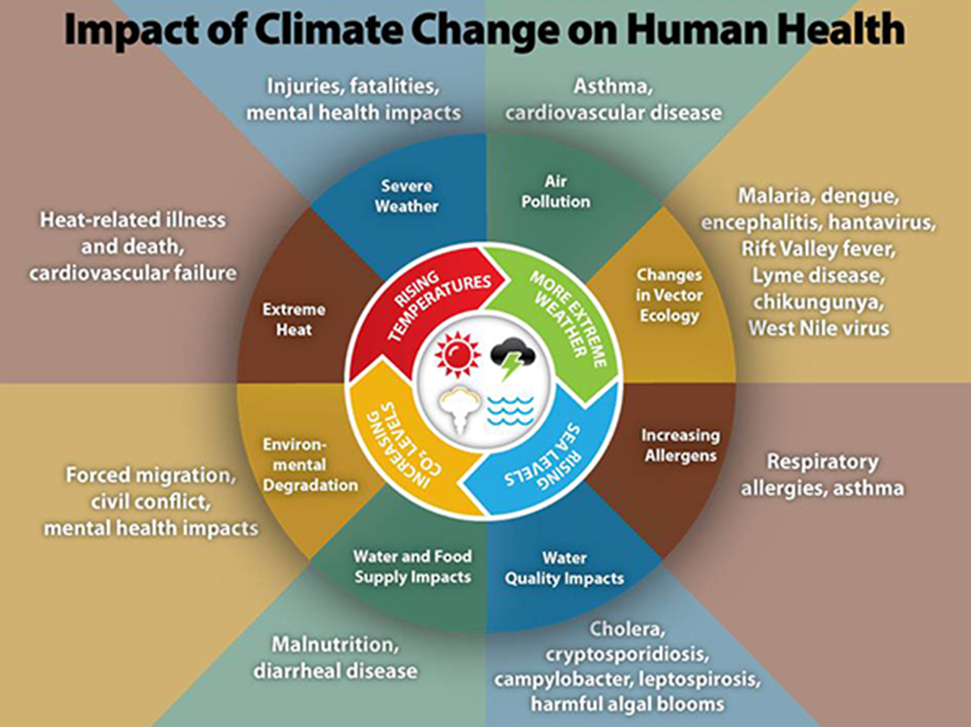
CDC Chart on Climate Change
Notes:
Source: http://www.cdc.gov/climateandhealth/effects/
The information on health effects has been excerpted from the Third National Climate Assessment’s Health Chapter. Additional information regarding the health effects of climate change and references to supporting literature can be found in the Health Chapter athttp://www.globalchange.gov/engage/activities-products/NCA3/technical-inputs.
Climate change, together with other natural and human-made health stressors, influences human health and disease in numerous ways. Some existing health threats will intensify and new health threats will emerge. Not everyone is equally at risk. Important considerations include age, economic resources, and location.
In the U.S., public health can be affected by disruptions of physical, biological, and ecological systems, including disturbances originating here and elsewhere. The health effects of these disruptions include increased respiratory and cardiovascular disease, injuries and premature deaths related to extreme weather events, changes in the prevalence and geographical distribution of food- and water-borne illnesses and other infectious diseases, and threats to mental health.

Slide 9
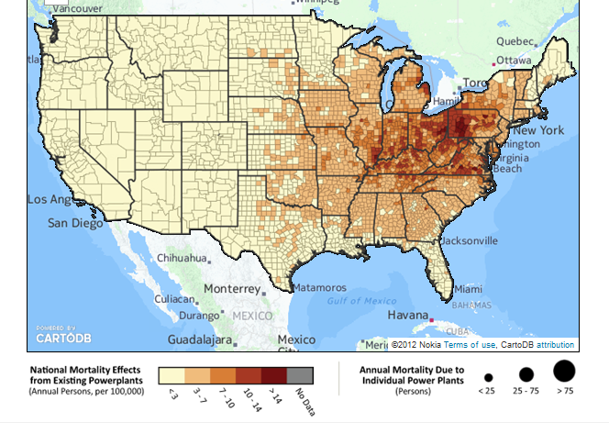
Energy use is a public health issue
*Healthcare is 2nd most energy-using sector in the U.S.:
73 trillion kwh of electricity/yr
~$600 million/yr in healthcare costs related to increased
respiratory disease burden
*U.S. hospitals consume 2x as much energy/ft2 as European counterparts
Notes:
Lancet – climate change the public health issue facing us
AAP policy statement on climate change

Slide 10
What is U.S. electricity generation by energy source?
In 2013, the United States, about 67% of the electricity generated was from fossil fuel (coal, natural gas, and petroleum).
Coal 39%
Natural Gas 27%
Nuclear 19%
Hydropower 7%
Other Renewable 6%
Biomass 1.48%
Geothermal 0.41%
Solar 0.23%
Wind 4.13%
Petroleum 1%
Other Gases < 1%
*Source: U.S. Energy Information Administration
Notes:
Coal is the single largest source for energy generation

Slide 11
Environmental Health
With the highest carbon content of all the fossil fuels, carbon dioxide emissions from coal combustion represented 24.5 percent of total U.S. greenhouse gas emissions in 2012.
Notes:
Source: http://www.c2es.org/energy/source/coal

Slide 12
88% of Coal Reserves will have to be left in the ground to stay under 2 degrees of warming Source: Rosamund Pearce, Carbon Brief derived from McGlade et al. (2014)

Slide 13
Estimated health effects from U.S. coal-fired power plant emissions
A 2010 study by the Clean Air Task Force estimated that in the US on an annual basis, air pollution from coal-fired power plants accounts for more than:
13,000 premature deaths
20,000 heart attacks
1.6 million lost workdays
The total monetary cost of these health impacts is over $100 billion annually.
Source: Schneider, C., and Jonathan Banks. 2010. The Toll From Coal: An Updated Assessment of Death and Disease from America’s Dirtiest Energy Source. Clean Air Task Force, September.

Slide 14
Mitigation
1. Energy Efficiency
2. Renewables
3. Greenhouse Gas (GHG) emission tracking and reduction

Slide 15
Healthier Hospitals Leaner Energy
Level 1: Reduce GHGs by decreasing energy use by 3% from baseline
Level 2: Reduce GHGs by decreasing energy use by 5% from baseline
Level 3: Reduce GHGs by decreasing energy use by 10% from baseline
Notes:
Mitigation starts first and foremost with reducing the energy use. Join the Healthier Hospitals Leaner Energy challenge for resources to get started.

Slide 16
Renewable Energy Challenge
Coming soon to Practice Greenhealth!
Notes:
Source: Practice Greenhealth Benchmark Report 2015
Onsite renewable energy is going up slowly in award-winning hospitals, with slight increases (two to three percentage points) across the board. Onsite energy use fell slightly for Top 25 hospitals, likely a reflection of different hospitals achieving the honor in 2015 rather than any real decrease in renewable energy use. The purchase of offsite renewable energy stayed constant in 2014. Table 9 demonstrates that an increasing number of award-winning hospitals are purchasing some kind of renewable energy within their energy portfolios, with 21 additional hospitals reporting some renewable energy use in 2014.

Slide 17
What Are GHG Emissions?
GHG Emissions Are Measured in Metric Tons of Carbon Dioxide Equivalent (MtCO₂e)
GHG = CO₂ + N₂O * GWP + CH₄* GWP
GWP = Global Warming Potential
GHG Benchmarking and Reduction Challenges coming soon to Practice Greenhealth
GHG Emissions Are Categorized Into 3 Scopes

Slide 18
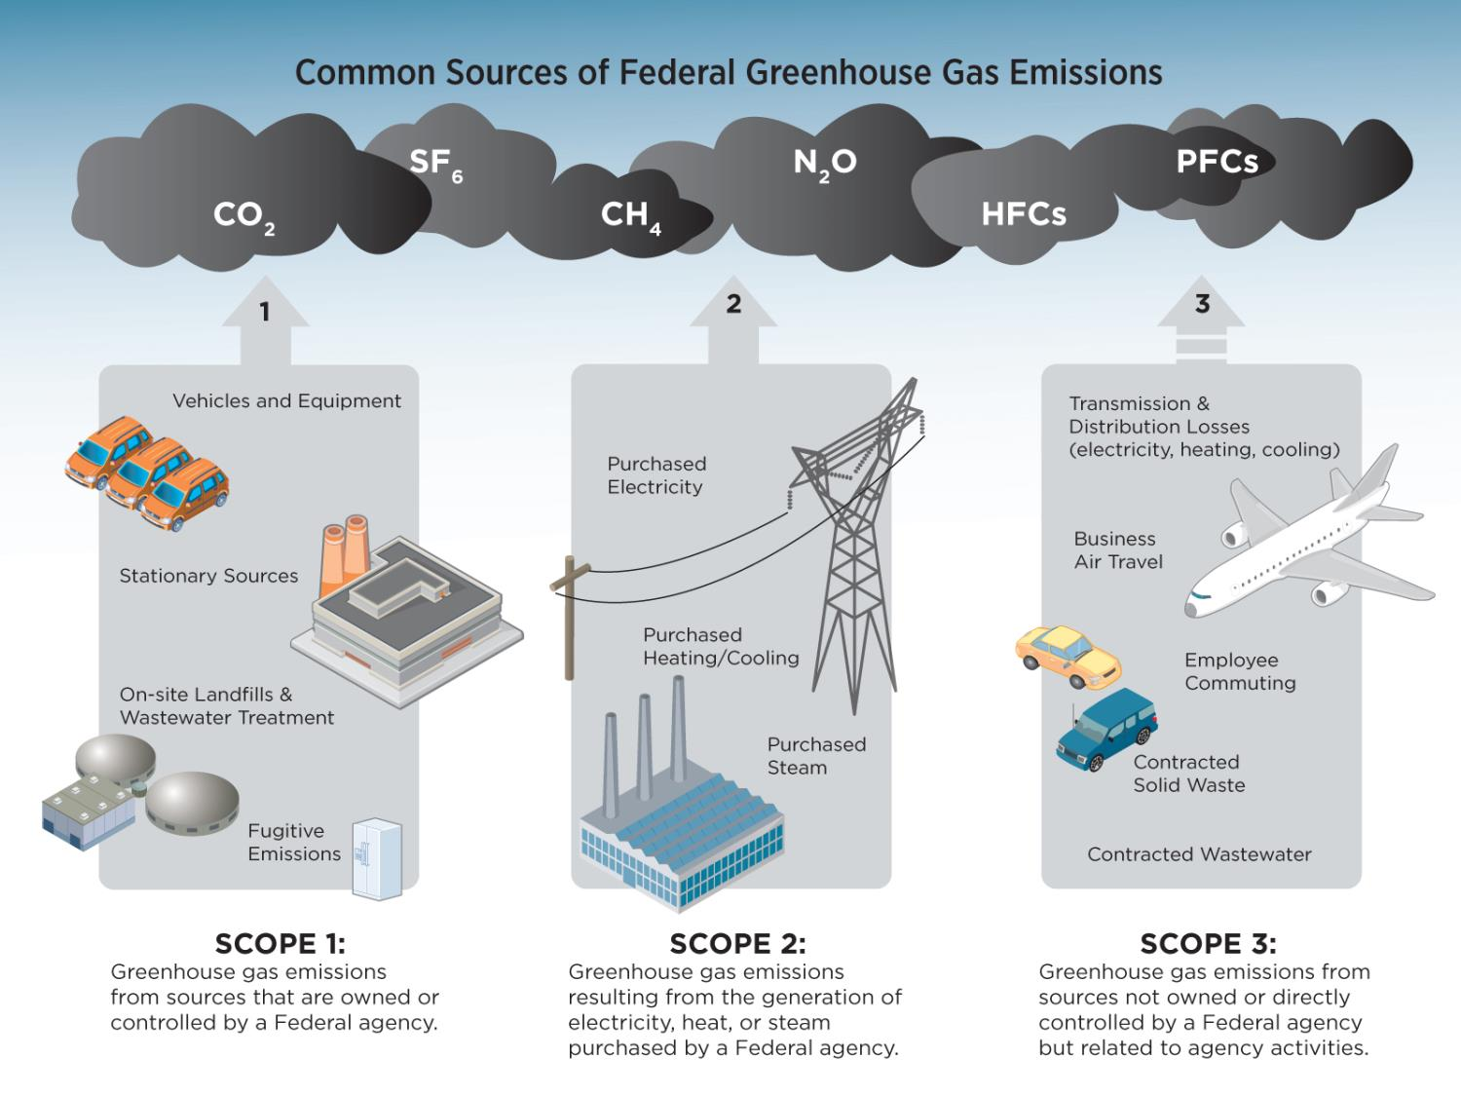
Notes:
Source: http://energy.gov/management/spo/common-sources-federal-greenhouse-gas-emissions

Slide 19
Climate Resilience for Health Care
Developing and maintaining data on climate hazards and infrastructure vulnerabilities
Understanding the regulatory, design, and land use context of a facility’s location
Constructing or retrofitting infrastructure in manner that is both sustainable and better at withstanding future events
Prioritizing resilience measures for high priority, vulnerable functions and areas
Strengthening ecosystems and natural buffers to mitigate floods, storm surges, and other hazards to facilities
Notes:
Source: https://toolkit.climate.gov/topics/human-health/building-climate-resilience-health-sector
Source: https://www.whitehouse.gov/administration/eop/ceq/Press_Releases/December_15_2014
Health care organizations play a key role in community resilience. Climate change, by increasing the intensity and frequency of some extreme weather events, is creating complex hazards that challenge accepted baseline assumptions for infrastructure capabilities, redundancies, and disaster preparedness and response—and this means a need for new building design thresholds.
Essential health services must remain available to communities and individuals during and immediately following extreme weather events, even during extended utility outages and transportation infrastructure disturbances. Resilient health care organizations must anticipate extreme weather risks and transcend limitations of regional public policy, local development vulnerabilities, and community infrastructure challenges as they site, construct, and retrofit health care facilities.

Slide 20
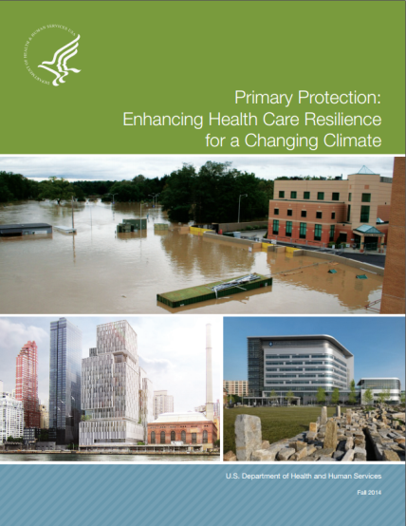
Climate Resilience Toolkit
Toolkit and checklists available to get started for hospital resilience planning
Notes:
Source: https://toolkit.climate.gov/topics/human-health/building-climate-resilience-health-sector

Slide 21
Partners Spaulding Rehab Hospital
A hospital of the future that is designed for resilience and an ability to continue operations in the event of extreme weather events and sea level rise or surge, as a result of climate change.
Remediation and redevelopment of a waterfront brownfield site reflects Spaulding's commitment to the "rehabilitation of people and place,” to the City of Boston, the community of Charlestown and the goal of providing access to water for therapeutic purposes.
Offered as a development site by the City of Boston, the hospital has become an exemplar of resilience strategy and planning.
Design integrates essential program requirements, a therapeutic environment, climate resilience and beauty.

Slide 22
Leadership: The Health Sector Drives Global Transformational Change
Notes:
This is not the first issue that health care has been the leading voice on – just look back to issues such as tobacco, mercury, and incinerators. Health care has led before, and will continue to lead on climate change.

Slide 23
Role for Health Sector in Climate Change
Mitigation: Leading by Example in Reducing Its Own Climate Footprint
Resilience: Anchoring the Resilience and Preparedness to Climate Change Impacts in Communities
Leadership: Advocating for Policies to Accelerate Transition to Climate Stable - Healthy Future and Rebranding Climate Change as Public Health Imperative

Slide 24
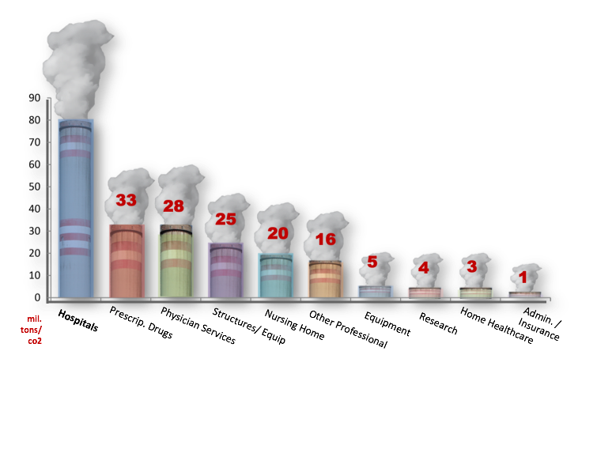
Health care is responsible for 217 million tons of CO2 each year, with hospitals representing 3% of the US total output (80 million tons)
Data Source: JAMA 2009
Notes:
In fact, U.S. healthcare puts 217 million tons of carbon into the atmosphere every year.
Hospitals alone contribute more than 3% of the country's total output – 80 million tons. Our hospitals use two-and-a-half times the energy of European hospitals, which are in countries that rank higher in health status, and have lower costs.

Slide 25
Health Based Communications
Framing climate change as a public health issue
Health professionals are trusted messengers
Notes:
Source: http://environment.yale.edu/climate-communication/articles/archives/C72
Source: http://environment.yale.edu/climate-communication/article/global-warmings-six-americas-perceptions-of-the-health-risks/
For example, an open-ended question asked respondents “In your view, what health problems are Americans experiencing from global warming, if any?” Only among the Alarmed did a majority (60%) accurately name a health problem associated with global warming (e.g., allergies, heat-related illnesses, vector-borne infectious diseases, etc.). Most respondents in the other segments had no response, didn’t know, or said there are no health problems from global warming. - See more at: http://environment.yale.edu/climate-communication/article/global-warmings-six-americas-perceptions-of-the-health-risks/#sthash.k5pb1Iq6.dpuf
This demonstrates the massive opportunity that health professionals have to educate the public on this issue.

Slide 26
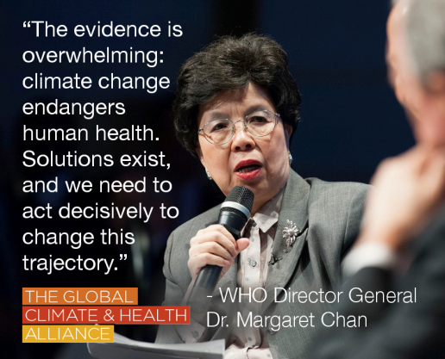
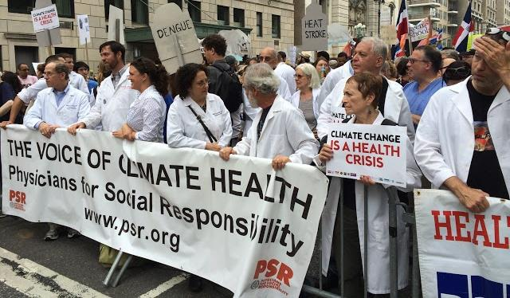
Voices for Climate Health
Notes:
Health professionals and health leaders have started to speak out.
Leader of WHO has publicly acknowledged climate change as an urgent public health issue.
Doctors, med students, and health professionals at Climate Marches in NYC and London, September 2014

Slide 27
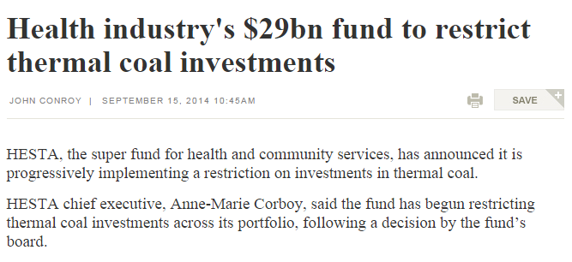
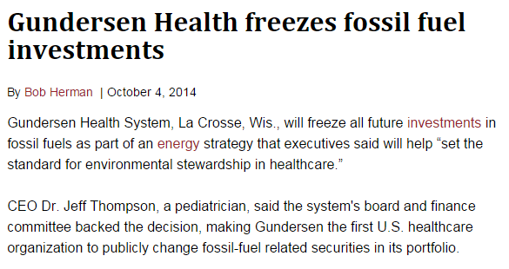
Healthy Investments: Health Sector Divestments Gaining Traction
Notes:
3 health organizations on 3 continents made fossil fuel divestment (or restriction of investment) commitments in 2014:
BMA (June)
HESTA (Sep)
Gundersen Health System (Sep/Oct)
Images courtesy Healthy Planet UK

Slide 28
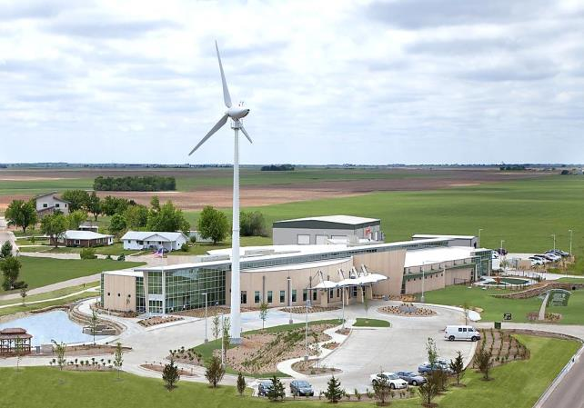
Health Care Climate Council
Coalition of nation’s largest healthcare systems conducting advocacy on climate and health issues. Members represent $100 billion in revenues
Highlighting leadership through large scale investment in renewable energy, implementing climate resiliency and divestment from fossil fuels
Notes:
Source: https://noharm-uscanada.org/healthcareclimatecouncil

Slide 29
Questions?
Contact:
Lauren Kleinman, Outreach and Engagement Specialist at Practice Greenhealth
lkleinman@practicegreenhealth.org
Eric Lerner, Director of HCWH’s Climate Program
elerner@hcwh.org

