Slide 1

Environmental Stewardship and Employee Engagement
A Winning Strategy
www.practicegreenhealth.org

Slide 2
Employee Engagement Toolkit
White Paper and Literature Review
Case Studies
Educational Webinars
Engagement Check-List
Other Resources
Photo: Art from Advocate Health Care
Notes:
The Practice Greenhealth Employee Engagement Toolkit explains the value of employee engagement and how sustainability programs can be one facet of an overall engagement strategy. This offers an opportunity for green team leadership to connect with human resources, marketing, communications and education to make the important link between engagement and healthier environments. Environmental Stewardship is an opportunity to further demonstrate leadership’s commitment to health and well-being for staff, patients and the community. The toolkit includes a dozen case studies of how PGH members engage its staff, a literature review, white paper, two educational webinars (archived) and an employee engagement check list to facilitate engagement activities.

Slide 3

Why Is Employee Engagement Important?
US businesses lose $11 billion annually as a result of employee turnover.
Profitability
Staff Satisfaction at Work
Staff satisfaction relates to Patient Satisfaction
Bureau of National Affairs
Notes:
Today, employee engagement and loyalty are more vital than ever before to an organization’s success and competitive advantage. Gone are the days when a young person starting out in his or her career joined a company and stayed until retirement – in today’s business environment there are no guarantees. Experts predict the current turnover rate may rise to 65%. With recruiting costs running approximately 1.5 times annual salary, the ability to engage and retain valuable employees has a significant impact on an organization’s bottom line.
A 2014 survey from NSI Nursing Solutions, Inc. found the following results in the health care sector:
The 2014 turnover rate for the healthcare industry was 16.5%. The average cost of turnover for a bedside RN (registered nurse) ranges from $44,380 to $63,400
An engaged worker is one who exceeds expectations. One who goes the extra mile.

Slide 4


Notes:
According to a 2010 Towers Watson Global Workforce study the study, only about half of the 20,000 health-care survey respondents expressed a generally favorable view of their organization's leadership. Here’s what the data showed what employees sought out of leadership: that leadership is trustworthy and that they care about the well-being of others.

Slide 5

How to engage employees?
Every employee, at any level in the company, wants three things from their job besides money. They can be remembered using the acronym PAL:
Purpose
Appreciation
Learning
Resource: Paul Spiegelman, Co Author of “The Patient Comes Second”
Notes:
Paul Spiegelman, Chief Culture Officer for Stericycle and PGH Webinar presenter (archived) frames it quite simply – Every employee wants three things besides money:
Purpose – Every employee wants to know the overall purpose for the company (how it makes the world a better place) and how their work connects to that purpose.
Appreciation – Every employee wants to feel recognized and valued for the work they do.
Learning – Every employee wants to feel like there is an opportunity to learn and grow.

Slide 6

How do we engage employees?
Three Key Drivers to Employee Engagement
  Relationship with supervisor
  Belief in Senior Leadership
  Pride in working for the
  company
    Also treated with respect, personal
    values respected and the organization
    cares about how they feel.
Dale Carnegie in partnership with MSW Research
http://www.dalecarnegie.com/assets/1/7/driveengagement_101612_wp.pdf
Notes:
Dale Carnegie teamed with MSW Research to study the functional and emotional elements that affect employee engagement. A national representative sample of 1,500 employees was surveyed, which revealed that although there are many factors that impact employee engagement, there are three key drivers:
• Relationship with immediate supervisor
• Belief in senior leadership
• Pride in working for the company
employees said that believing in the ability of senior leadership to take their input, lead the company in the right direction and openly communicate the state of the organization is key in driving engagement. Other factors that drive engagement are that employees are treated with respect, that their personal values are reflected and that the organization cares about how they feel.

Slide 7
Sustainability as a driver:
What is Environmental Sustainability?
Sustainability: Latin sustinere – to hold up.
The capacity to endure, bear burden, hold up
2005 World Summit – Sustainability requires the reconciliation of environmental, social and economic demands – the three pillars of sustainability.
Brundtland Commission of the United Nations (March 1987): “…,meeting the needs of the present without compromising the ability of future generations to meet their own needs.”
Notes:
Practice Greenhealth members are working to improve their environmental performance – to make the connection between health of the environment and human health and to make decisions today that don’t negatively impact future generations.

Slide 8

Employee Engagement & Sustainability
Companies that engage their employees fully in sustainability efforts see the greatest impact, including on profitability
Organizations with advanced programs saw their efforts as a strategic advantage.
http://www.greenbiz.com/
GreenBiz Group Employee Engagement survey conducted in March 2014
Notes:
The Greenbiz Group Employee Engagement Survey, conducted in March 2014 showed that organizations with “advanced” programs now see the efforts to green their supply chains and harness sustainability more strategically – as sources of competitive advantage.
It’s not enough to improve environmental performance – educating, and including staff in sustainabilitiy activities can increase staff engagement and satisfaction overall AND bring sustainability programming to the next level. Increasingly, hospitals and health systems are recognizing the need for a more formalized engagement and communication strategy to best connect with the various stakeholders from clinicians to front-line staff, department leaders and the community. Through working with marketing and communications, messaging can be tailored to meet the needs of the stakeholders – a variety of communication strategies is key.

Slide 9
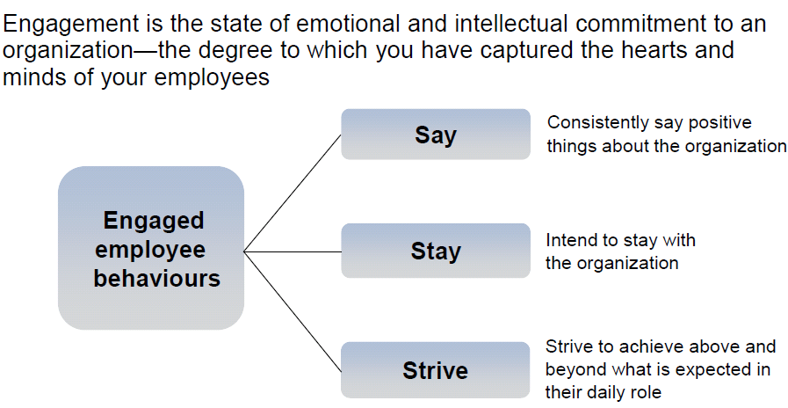
Employee Engagement Defined
.
Engaged employee behaviors
“Engaging Employees through CSR,” Canadian Business for Social Responsibility (CBSR) and Hewitt Associates webinar, January 2010. Based on a slide used during the webinar.
Notes:
Paul Spiegelman, co author of “The Patient Comes Second” argues “If employees are treated in a way that enhances their empowerment and personal growth, then it follows that people will be more productive, work harder and be happier because they are engaged and motivated.” The “Circle Of Growth™” as Paul describes it in his book, starts with team members and a focus on creating a collaborative and trusting work environment. That engagement should lead to customer/patient loyalty, and in turn drive financial results. Then the cycle simply repeats itself. According to Paul Spiegelman, measuring employee satisfaction and engagement is one of the leading indicators of how healthy a company is. Higher scores relate to higher patient satisfaction and better financial performance.

Slide 10
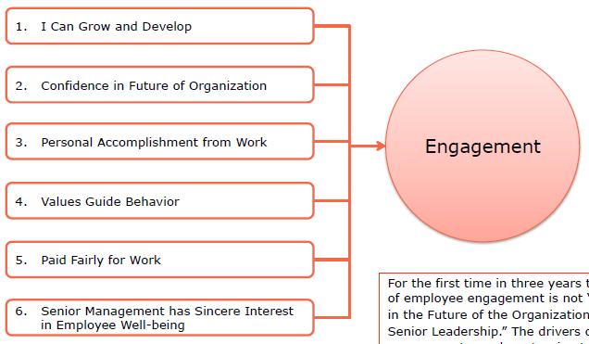

Six Drivers of Engagement
Notes:
Modern Health Care’s Employee Engagement Survey identifies the top drivers in employee engagement. Read the full report for detail on drivers of employee engagement in health care.
http://www.modernsurvey.com/wp-content/uploads/2013/12/The-State-of-Engagement-Report-Fall-2013.pdf

Slide 11


Making an Impact Matters
Employees who say they have the opportunity to make a
direct social and environmental impact through their job
report higher satisfaction levels than those who don’t, by a 2:1 ratio.
Net Impact’s “Talent Report: What Workers Want in 2012,” June 2012,
Based on a survey of 1,726 senior university students and employed graduates.
Notes:
More and more, prospective employees are seeking job opportunities in organizations which reflect and align with their own in regard to environmental stewardship. According to a 2014 survey by Pew Research Center, 80% of Millennials (born after 1980) want to work for companies that care about its impacts. They choose bikes over buses and cars and will spend more for healthier products. The year 2015 marks the first time the millennial generation will outnumber their older colleagues in the US workforce. Generation X-ers and millennials are not driven by financial rewards alone. They look for inspiration and creativity. Employees want to be on the winning team.

Slide 12
Sustainability & Engagement Case Studies
Advocate Health Care
Beaumont Health System
Cleveland Clinic
Hackensack University Medical Center
Inova Health
Johnson & Johnson
Metro Hospital
Ridgeview Medical Center
Stericycle
UCSF Medical Center
University Hospitals Health system
Virginia Mason
Notes:
Early Adopting Practice Greenhealth members are actively creating strategies to increase staff engagement around sustainability programming. Facilities share ideas, learn from each other and try out new ideas. There is no one answer, or one solution and what works well at one facility may not work for another. Common themes include recognition, departmental check-lists, sustainability in satisfaction surveys, staff certification or development programs and ongoing education. The case studies can be found in the employee engagement toolkit – share them with your team, use the employee engagement check list and start developing your pilot program or expand upon engagement strategies for maximum return. Here are a few highlights:

Slide 13


Advocate Health Care
Green Advocates and Sustainable Work Space Certification
- 11 hospital system, Chicago area
Striving for Wellness for All
Green Advocate Program
Sustainable Work Space Program
Healthe You Partnership
Notes:
Advocate Health Care strives to create a culture of conservation and improve the health of people and the environment. At Advocate, conserving natural resources is one facet of their commitment to health and corporate citizenship.
They see sustainability initiatives as an important part of wellness and managing health care costs. To motivate and engage staff, Advocate focuses on communication, education and recognition programs. These efforts are intended to win the hearts and minds of staff and motivate them to take action at work to reduce waste, energy and support healthier spaces. Two of the programs developed to do this are the Green Advocate Program and the Sustainable Work Space Program.
In order for Advocate Health Care to achieve its goal of health and wellness for all, it requires education and communication across the 11 hospital system, the medical group and clinics. Top down communication is one thing, but to bring programming to the next level, people have to live it. Advocate leadership recognizes that a commitment to healthier environments helps to support both personal health and minimize health care costs. The foundational message for Advocate’s communication and education programming connects how environmental health is essential for human health to thrive.
Green Advocate and Sustainable Workspace Check-list: The Green Advocates program was developed to extend sustainability initiatives to the departmental level and increase staff engagement across the system. The program empowers passionate associates so that they have an increased role in sustainability programming. While the system drives key performance goals around energy, waste, reprocessing and paper reduction, each site benefits from the Green Advocate to increase departmental level buy in and maximize their involvement and satisfaction.
The goal is to identify a minimum of one Green Advocate per department and reward the individual to a health and wellness benefit through the employee health benefits program. The green team leadership of each Advocate hospital explains the Green Advocate designation at leadership meetings and requests department heads to identify key staff appropriate for the role. The Green Advocate designation is designed with simplicity in mind. There is no required meeting attendance so any associate can be designated. They are empowered to use Advocate’s Sustainable Workspace Check-list which was modeled after New York Presbyterian’s program (which was modeled after Harvard University’s Greenleaf Program) to conduct departmental audits. The checklist is customized to include common operational elements such as defaulted printer settings for double sided printing and copying, recycling collection and installation of occupancy sensors to reduce energy, to name a few.
When a Green Advocate succeeds in achieving Sustainable Workspace certification for their department, they are rewarded with bonus points toward Advocate’s health and wellness incentive raffle.
Each Green Advocate is given a certificate signed by their hospital president and the framed certificate is hung in the department. Green Advocates are photographed with the president and identified in staff newsletters. Advocate Health Care’s goal was to get 50 percent of all hospital departments certified by earth day 2015. Success is dependent on leadership’s engagement and marketing efforts. Hospitals within the system progress at varying levels. Some hospitals have identified a few Green Advocates and others are leading the way and thinking about developing patient facing information and marketing materials.
A Life of its Own
While system strategies and Green Advocates build upon environmental improvements, other projects have developed organically. The culture is created where passionate individuals can take on a project, get others involved and it takes on a life of its own. An example of this is gardening. Workers have engaged around community gardening and kindness to the planet earth. Numerous Associates have been involved with gardening projects. At Advocate Sherman Hospital, a team of leaders organized the creation of community garden of 53 beds on the hospital’s campus for staff and community members to tend to during the growing season. Their surplus harvest is donated to a local food pantry. In another similar example, Advocate Good Shepherd Hospital has partnered with Smart Farm, a local non profit to build a high tunnel hoop house and outdoor garden to grow vegetables solely for donating to a local food pantry. Staff at the hospital volunteer time tending the garden and the hospital kitchen donates food waste for garden compost. Farmers markets are also held on several of the hospital’s campuses during the summer months and coupled with healthy eating and seasonal recipe sharing.
Branding for sustainability – To further strengthen the relationship between the environment and human health, Advocate branded their environmental stewardship and associate health and wellness
partnership as Healthy Environment – for the quarterly dashboard, computer based training, annual report and award program.
Green Advocate recruitment started in 2012, Sustainable Workspace Certification in 2012, hired a system manager in 2011, and held its first annual environmental stewardship awards recognizing staff in 2011

Slide 14
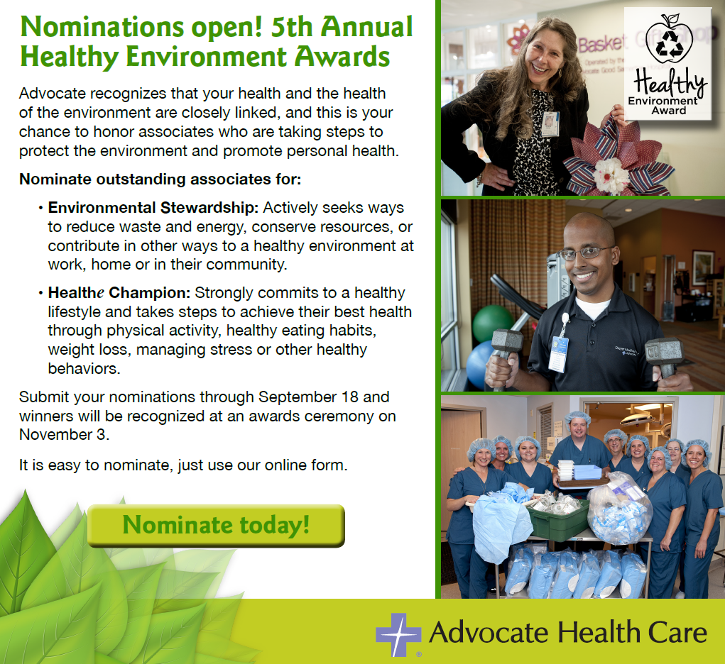
Notes:
Recognition – Fifth annual environmental stewardship awards on November 3, 2015! Prior to 2014, Advocate held an annual event recognizing associates demonstrating going above and beyond in environmental stewardship at work and in their personal lives. In 2014 the team created a program that recognizes associates that are excellent environmental stewards AND healthy champions, bringing together sustainability and health. Peers are nominated for their accomplishments in energy, water and waste conservation, weight loss, team work, collecting materials and more. A team reviews the nominations and each year identifies 25 winners from across the system, with at least one winner from each site. In 2014, winners included several physicians and nurses and a variety of Associates from various departments. The method of awards and recognition leads to fantastic opportunities for story-telling. Winners are appreciated, honored and enjoy a breakfast with their CEO, where they bring their family, have their photograph taken and tell their story. Photographs are shared and in 2014 a video was developed to share the stories. The event is an opportunity for Jim Skogbsbergh, Advocate’s president and CEO, to talk about Advocate values, mission, innovation, stewardship, health and wellness and to give a deserved pat on the back for a job well done. The Vice President of Mission and Spiritual Care does an invocation to kick off the event. Those that are not selected from the nomination, receive a thank you letter from the Sustainability team, with a copy to their one up manager or supervisor and the colleague who nominated them. In 2013, Green Advocate buttons were created and sent along with the thank you note. A nomination is an honor – and it’s important to lift people up and celebrate their accomplishments. Advocate Health Care 2014 Healthy Environment Awards Video http://content.jwplatform.com/players/CKuYql0p-tTYXgVHu.html

Slide 15
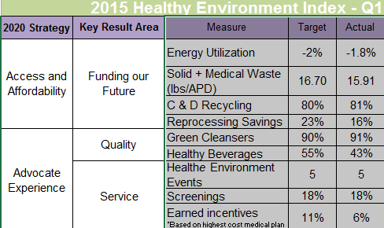
Communication and Measurement
Advocate Health Care Healthy Environment Report
“My site is environmentally responsible.”
- Staff Survey – RESULTS: Above national benchmark!
Healthy Environment Quarterly Dashboard
Notes:
The constant question for the system is “How do we engage?” and this is an important question for all to consider in the complex health care system. In a world of competing initiatives, consistent messaging and keeping it fresh, simple and fun are key to success. A critical partner in sustainability and wellness programming is public affairs who create the messaging. Communication is challenging in health care – and requires varying strategies, depending on the audience. For example, emailing is not a successful strategy for many nurses at Advocate because they simply do not access email habitually as part of their work day. A variety of communication strategies are identified from emails to Facebook, an intranet web page, poster campaign, annual training and Instagram, to name a few. Messaging is “bite size” information to increase understanding and to keep it simple. Advocate’s Environmental Stewardship, Communications and Organizational Development team collaborated on the development of a computer based tutorial on sustainability and health. The tutorial attempts to connect the dots between sustainability and health, why it is relevant and important and how each person can make choices each day to support environmental and personal health simultaneously.. Participation in the tutorial enters them into a raffle for an iPad or a FitBit
Another method of engagement is for managers to get their staff to take Advocate’s annual engagement survey. They are asked to measure the accuracy of this statement, “My site is environmentally responsible.” This survey question plants the seed around sustainability and healthier environments. A formal sustainability report shares updates with staff, patients and the community and is featured on the website Advocate Health Care Healthy Environment Report

Slide 16


Ridgeview Medical Center
Program Goal
Continue to leverage sustainability as a catalyst for employee engagement.
Notes:
Brief Description: Ridgeview Medical Center located in Waconia, MN started its sustainability journey 15 years ago. This program was catalyzed by the CEO, with a great caveat shared by Todd Wilkening, Director of Facilities and the sustainability lead for Ridgeview Medical Center – “the executive team was adamant that this become an initiative, that needs to be built from the ground up!”
The employee engagement program was catalyzed by Ridgeview’s energy program. Ridgeview’s representatives throughout the organization have the great title of: Energy Protective Agent – EPA. The EPAs were responsible for spreading tips/ideas for energy efficiency at the department level. This program evolved into EPA’s spreading tips/ideas. Ridgeview views the green team as the hub and the EPAs as the communication liaisons to the departments within the hospital.
Challenges: Ridgeview’s green team has identified the communication aspect of sustainability to be one of the key challenges to ensure sustainability does not become stagnant. The green team has created a position called the Green Team Communication Champion! Ridgeview feels that there are many projects and the struggle is to communicate the opportunities for sustainability internally.

Slide 17

Lights off Campaign
Fluorescent lights save energy the moment the light is turned off. So, get in the habit of “flipping the switch” when you leave your office or conference room.
Notes:
In 2012, Ridgeview started to implement a number of energy efficiency projects. Concurrently, the team started to analyze employee behavior as it relates to energy usage. The mindset is health care is a 24/7 operation, but not every space operates that way. This allowed Ridgeview to create a list of low and no cost actions for employees to help with energy conservation throughout the hospital.
An exciting development from the opportunities that evolved for employees was the team’s desire to personalize energy efficiency. This lead to at home checklists and energy efficiency tips that are added to employee check stubs. Examples include lowering hot water heater setting, allowing dishes to air dry rather than utilizing the dishwashers drying function and installation of a programmable thermostat.
The personalization component is an important feature at Ridgeview. They feel that helping people incorporate sustainability into their homes allows for greater buy-in when programs are launched at the hospital.

Slide 18
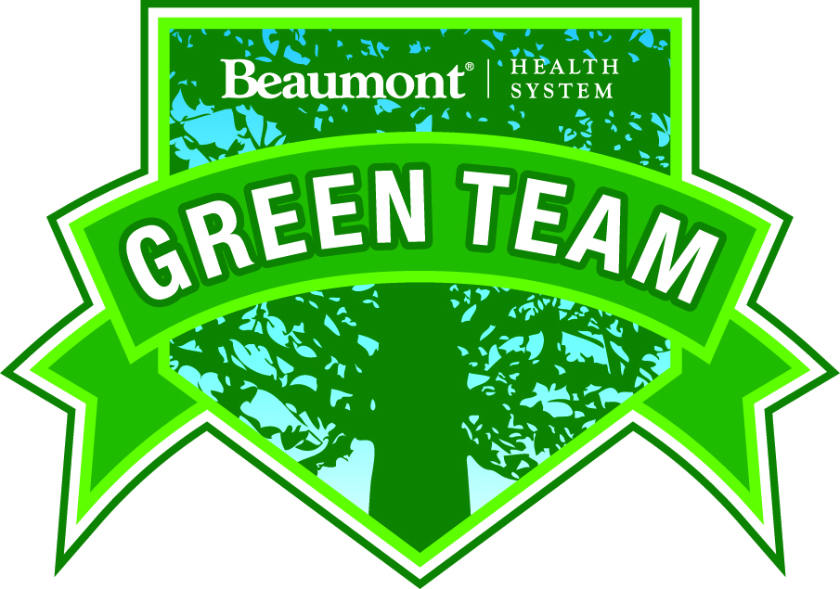

Green Officer Program
Education
Role Models
Recruitment
Trained to assess departments
Team Audits complement
www.beaumont.edu.
Notes:
Beaumont Health System includes three hospitals with 1,778 licensed beds, more than 20,200 employees and 3,100 physicians, including 553 employed physicians in the Beaumont Medical Group and more than 2,500 private-practice physicians. In addition to its hospitals in Royal Oak, Troy and Grosse Pointe, Michigan, Beaumont has 54 community-based sites of care including medical centers in Oakland, Macomb and Wayne counties, family practice and internal medicine practices, five nursing centers, home care services and hospice. The Beaumont Research Institute has 924 open research studies including 270 clinical trials with more than 7,800 participants. Beaumont is the exclusive clinical teaching site for the Oakland University William Beaumont School of Medicine.
The Green Officers program kicked off in 2009. This is a voluntary program where interested staffers help communicate and educate others about sustainability programming. Any staffer can volunteer to be a Green Officer. The Green Officers act as role models to other staff through energy, water and waste conservation practices and they help to recruit new Green Officers. Green Officers are trained to assess their individual department to identify opportunities for further waste reduction, recycling and other environmental improvements. Once opportunities are identified, they are connected with the expert for implementation. For example, a Green Officer may identify a need for motion detection for lights to shut off in individual offices and would be connected with Facilities Management for completion. This helps to address the numerous small improvements that are part of larger goals, in this case, around energy performance. Another example is a department identifying a significant generation of plastics, leading to a connection with Environmental Services to increase recycling for this area.
Green Officers participate on a one-time training (Beaumont University). This is where they are educated on programmatic specifics and provided with updates of existing programs. The 90-minute training includes a slide presentation and requires a test to demonstrate an understanding of roles and responsibilities. While the training was initially conducted on each site by the site lead, it is now recorded and streamlined with a standardized message for all staff. The site lead follows up with a site-specific tour and for answering any questions. Green Officers continue their education by attending Green Officer Town Halls, which are offered 6 times per year. Green Officers receive a pin that is affixed to their ID, clearly identifying their role to others. However, Green Officers are not the only way to engage departmentally. As a quality protocol, a team audits the buildings twice a month, looking for opportunities around water and electricity, two Beaumont goals.
Job Description for Green Officers:
Educate and advocate for practices at Beaumont, consistent with the Beaumont plan.
Role model green behaviors
Use revolving doors
Use reusable mugs and bottles
Turn off lights
Power down computer and printers
Recycle paper, plastic, cardboard
Don’t use carry out containers for food if you are not carrying out, be an advocate. Don't criticize, share the green plan with co-workers
Look for ways to reduce, reuse, and recycle goods
Look for ways to reduce water and power consumption
Share ideas with Green Team. Share ideas on Green Blog

Slide 19
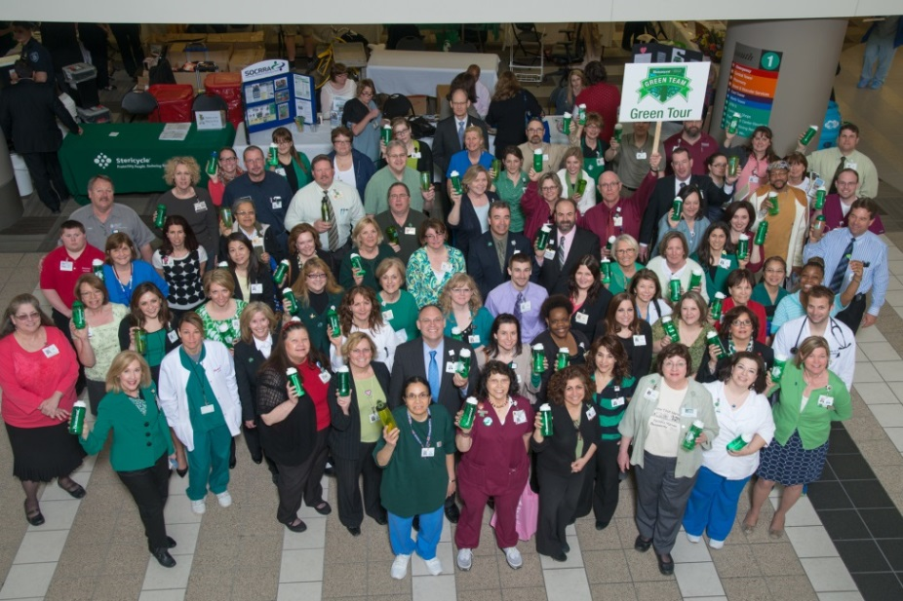
Measurement
The Number of Green Officers –
  2011 – 124 Green Officers
  2012– added 184
  2013– added 190
  2014 - Added 182 with a total
  of 680 by 2015.
Employee engagement
survey - The employee survey asks,
“Does the organization care about my health?” and staff rates their impressions
Notes:
There were initial challenges around getting staff to attend the Green Officers Training. Success was realized when certain Department heads identified that all of their staff or supervisors become green officers and the entire department would get onboard. Another strategy included bringing the training to key departments, like nursing or the operating room, and conducting the training in their own space. Other challenges include its impact on overall staff engagement. As a result, a cohort of University of Michigan students from the School of Natural Resources Master’s Program have taken on this project. Through the development of a survey, the team has committed to developing a strategy to measure staff and patient impressions around sustainability initiatives and connection to their own health. While leadership is supportive of sustainability initiatives, the question remains, does it lead to organizational performance improvement? This is the question that they seek to answer through working with the University of Michigan graduate students.

Slide 20
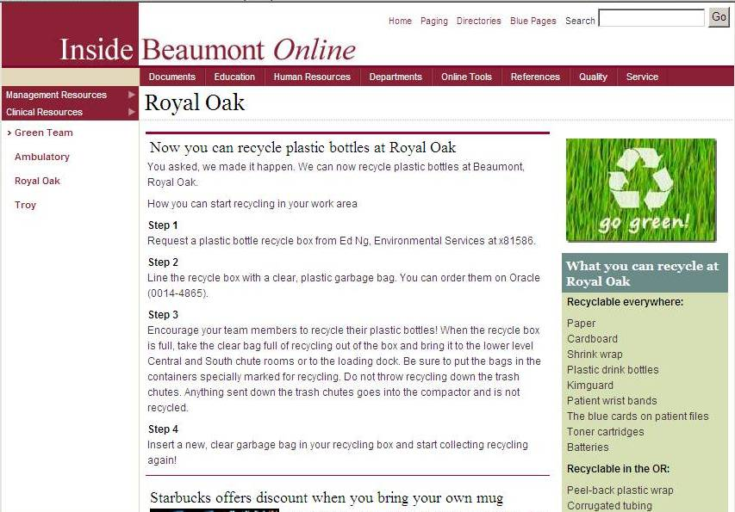
Communication
Notes:
Communication – A Green Officer Blog is a way to provide continuous updates and a feedback forum. The blog is written by Green Officers and by Green team participants. For example, a new initiative which was featured in the training and through the blog is the greening of the Gift Shop. The Green Intern wrote the blog, about activities that had taken place in the Gift shop to reduce waste and energy use. (sample attached) Other communication strategies include posters and staff memos.
An example of an idea from the blog: One staff noticed that coffee pots were heating water 24/7 so they put timers on the pots so that they weren’t heated up on off-hours. This helped reduce energy use. The garden was an employee and volunteer initiative. A staff member reported that sprinklers turned on when it was raining. They installed a system to detect moisture to prevent use of sprinkler.
What Does Success Look Like?
The more staff that is designated as Green Officers, the more staff is engaged with sustainability programming overall. Staff brings their ideas and sees those recommendations addressed. This demonstrates that their voice is heard and there is a process for them to take an active role in the improvement of their workplace environmental and actively participate in positive change.
What’s Next – Digital Session for Green Officer Training and the survey to measure impressions of sustainability programming.

Slide 21

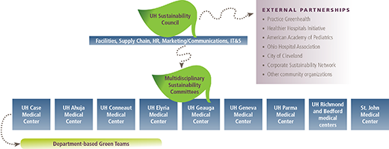
Formalized Structure
Comprehensive Communication Plan
Staff Recognition with Green health heroes
Sustainability Certification
Notes:
NEED TO ADD HEALTH SYSTEM DETAILS HERE
[DEMOGRAPHICS
University Hospitals, the second largest employer in Northeast Ohio with 25,000 employees, serves the needs of patients through an integrated network of 15 hospitals, 29 outpatient health centers and primary care physician offices in 15 counties. At the core of this $3.5 billion health system is University Hospitals Case Medical Center, ranked among America’s 50 best hospitals by U.S. News & World Report in all 12 methodology ranked specialties. Its main campus includes UH Rainbow Babies and Children’s Hospital, ranked among the top children’s hospitals in the nation; UH MacDonald Women’s Hospital, Ohio’s only hospital for women; and UH Seidman Cancer Center, part of the NCI designated Case Comprehensive Cancer Center at Case Western Reserve University]
University Hospitals Health System structured its sustainability program on four pillars of wellness: Building Well, Operating Well, Buying Well, and Living Well. UH has developed multiple approaches to employee engagement in its sustainability efforts: general communication strategies, a system wide sustainability council and facility-based committees, Green Health Heroes, and the latest project – a Sustainability certification program for managers.
Sustainability Council and Committees
The first step was to develop a coordinated structure for effective communication, goal-setting, and sustainability-related project implementation throughout the system. Leveraging the HHI Engaged Leadership challenge, the Office of Sustainability engaged the Director of Operations for each hospital across the system and collaborated with the CEO and all hospital Presidents to ultimately develop and sign off on an environmental statement of commitment for University Hospitals. The system-wide council is comprised of selected stakeholders from facilities, IT, clinical services, the Operations directors from each facility, marketing & communications, nutrition services, environmental services, human resources, and other key decisions makers.
Facility based sustainability committees are typically chaired by the Operations Directors at each respective hospital, meeting on a monthly basis, and in some cases facilities have chosen to incorporate sustainability programming into existing meetings such as Environment of Care meetings. Each committee addresses progress toward the HHI challenge goals, and data tracking and reporting is incorporated into these meetings. Leadership support was key in driving this initial momentum and support.
Green Health Heroes
The Green health Heroes program was developed as a way to recognize the efforts of individual employees. Green Health Heroes are peer-nominated employees of UH who champion sustainability above and beyond the call of duty. They take leadership roles in helping UH to advance environmental responsibility, promote health and wellness, and save costs to the health system . When a person is recognized as a Green Health Hero by a peer, he or she is interviewed and profiled on the external Greening UH Web page, credited $50 worth of UH Appreciates points, and acknowledged in front of colleagues and UH senior leadership at the annual employee sustainability celebration .

Slide 22
Sustainability Certification Program
Pilot for 35 managers at UH Geauga Site
Day Long training session
Collaborated with Case Western Reserve University to customize sustainability certificate track for program.
  Lecture followed by project based learning
  Presented to team and one project selected as pilot
  Project selected is chemotherapy dose rounding protocol with a projected savings of $163K per year.
Notes:
Sustainability Certification Program
UH completed a Sustainability Certification Program pilot for approximately 35 managers at UH Geauga Medical Center. These managers were required to attend a day-long training and participate in a group sustainability project. UH collaborated with Case Western Reserve University to customize their “Sustainability Certificate” track for this pilot training program.
The program included:
-Didactic session on corporate sustainability followed by project-based learning
-Development of projects that reflect each hospital’s strategic priorities and have measurable sustainability impacts. Pilot project group topics included wellness workplace design, community outreach, employee wellness programs, paper use reduction strategies and a chemotherapy waste reduction project.
-The groups then convened three months later to present their project presentations and results to a leadership panel.
The winning project chosen was a chemotherapy dose rounding protocol with annualized impact projected of $163,000. They are currently implementing the project system-wide and considering the next round of this training at another hospital.
The goal of the Sustainability Certification program is to both further progress on environmental innovation and to engage departmental managers in the process. The certification is a development opportunity for key staff and empowers them to improve processes and environmental impact.

Slide 23
Measurement
Total staff completing training
Survey results of training indicated “very applicable” to work after completing training
21 Green health heroes
$163,000 annual savings at one site from project selected.
Notes:
The measurable outcomes for the certification program include 35 managers completed the training
Survey results indicated that most participants rated sustainability as “very applicable” to their work after completing the training
Expected savings from project chosen: $163,000 annually at one hospital
Green Health Heroes:
21 Green Health Heroes to date
Communication Strategies :
Employee Energy competition
Bike Challenge Pilot Program (pilot year) – 130 active participants avoided 7 metric tons of CO2 emissions over 5 months, which is equivalent to driving 16,601 miles/year or growing 179 tree seedlings for 10 years
Stair Climb challenge - 208 employees
Page hits on intranet and extranet to understand what people are interested in and when
Greening the UH videos are the most popular in comparison to all UH videos

Slide 24

Communication
Greening UH Brand
General email
Topic Calendar
  Energy Awareness Month – Flip the Switch Campaign
  Employee Energy Challenge
  Recycling Month – Use Less, Recycle the Rest
  Food Day – Eat Real Food Photo Contest
  Earth Day Celebration – Recyclable material fashion show, sculpture contests, bike giveaway, reusable coffee mugs, tree planting, zero waste giveaway, basil plant give away in biodegradable container.
  Alignment with city of Cleveland on Year of Clean Water
Notes:
Communication –
UH utilizes a multitude of communication strategies for engaging employees around sustainability.
The Greening UH brand is on all communications so that it points back to the Sustainability Office, which ensures that employees know where to ask questions or how to get involved. There is a general email that employees can ask questions through or find out more information.
Another important way that UH connects to employees is by syncing up events with national and regional initiatives throughout the annual calendar. The program development aligns with those events under the Greening UH label. Here are a few examples:
Energy Awareness Month included a Flip the Switch campaign and the Employee Energy Challenge; Use Less, Recycle the Rest during Recycling Month; and Food Day incorporated an Eat Real Food photo contest
Earth Day celebrations have included a recyclable materials fashion show, sculpture contests, giveaways of bikes, reusable coffee mugs, tree planting, zero waste giveaway basil starter in biodegradable container
As 2015 is the Year of Clean Water for the Sustainable Cleveland 2019 Initiative, UH linked art with painted rain barrels to get people thinking about storm water and a reusable water bottle pledge incorporated into UH health premium discounts
Bike to Work Day programming awards wellness points (HealthMiles) and relates back to the overall UH transportation sustainability strategy
On the Greening UH webpage, there is a sustainability pledge (commitment to implementing changes at work and home) that employees can fill out which allocates UH appreciation points and health premium discounts. Each question has a “learn more” button to provide education as well as incentives to change individual behaviors.
Finally, the more general communication strategies include:
Combining sustainability with wellness – the message of public health has really resonated.
Communication is ALWAYS a positive message and focuses on celebrating the wins. This happens at each meeting, but the Sustainability Office also hosts a celebration at the end of the year to recognize the impacts for patients, employees and the community.
The Greening UH video series discusses the positive impacts that the program has and what it means to employees.
Annual report goes out to employees and the community.
Every single presentation reviews the four pillars of wellness (living well, buying well…etc.)
What Does Success Look Like?
Affecting positive change within a large and diverse health system requires constant contact with employees at all levels of the organization. Communication efforts necessitate a delicate balance of emphasis on triple bottom line priorities of social, economic, and environmental responsibility. This was understood with the establishment of the Office of Sustainability in 2010, which is why education and outreach was identified as one of the five key priority areas right from the start. The teams collaborate closely with the marketing & communications Department to reach employees and community members through a variety of media.
Link to http://www.uhhospitals.org/about/greening-uh/progress-report-on-sustainability

Slide 25

Engagement Summary
Orientation/Education
Departmental Champions
Departmental Check Lists
Staff Certification
Awards and Recognition
Employee Benefits
Communication Strategy
Making it Fun
Notes:
These are just a sampling of case studies from Practice Greenhealth members. Check the Practice Greenhealth website to download all 12 case studies to share with your team.

Slide 26






“
There are only a few activities a health system can do that will not only improve the health of community members and save money, but also engage staff and inspire their communities.
- Dr. Jeff Thompson, president and CEO, Gundersen Health
”
© Practice Greenhealth 2015. All Rights Reserved.
Notes:
A key component of going green is a communication strategy – poster campaigns, website, formal reporting and town hall meetings. It’s not enough to “do the right thing” – the next step is explaining the programs and why they are beneficial to staff, patients and the community. A commitment to health, a commitment to sustainability becomes part of the culture of an organization and something of great value.

Slide 27
Thank You & Discussion
For more information:
Janet Howard
Director, Member Engagement
Practice Greenhealth
jhoward@practicegreenhealth.org
www.practicegreenhealth.org

